Slide 1
OpenROAD: Toward a Self-Driving, Open-Source Digital Layout Implementation Tool Chain
Andrew B. Kahng
Depts. of CSE and ECE
UC San Diego
abk@ucsd.edu
http://vlsicad.ucsd.edu/~abk
Notes:
Good afternoon and thank you for the kind introduction. I am really honored to be among so many distinguished speakers in today’s program. Today I will introduce a project called OpenROAD in the IDEA program. OpenROAD aims for open-source, self-driving digital implementation.

Slide 2
Agenda
Motivations
Notes:
I start with brief motivation.

Slide 3
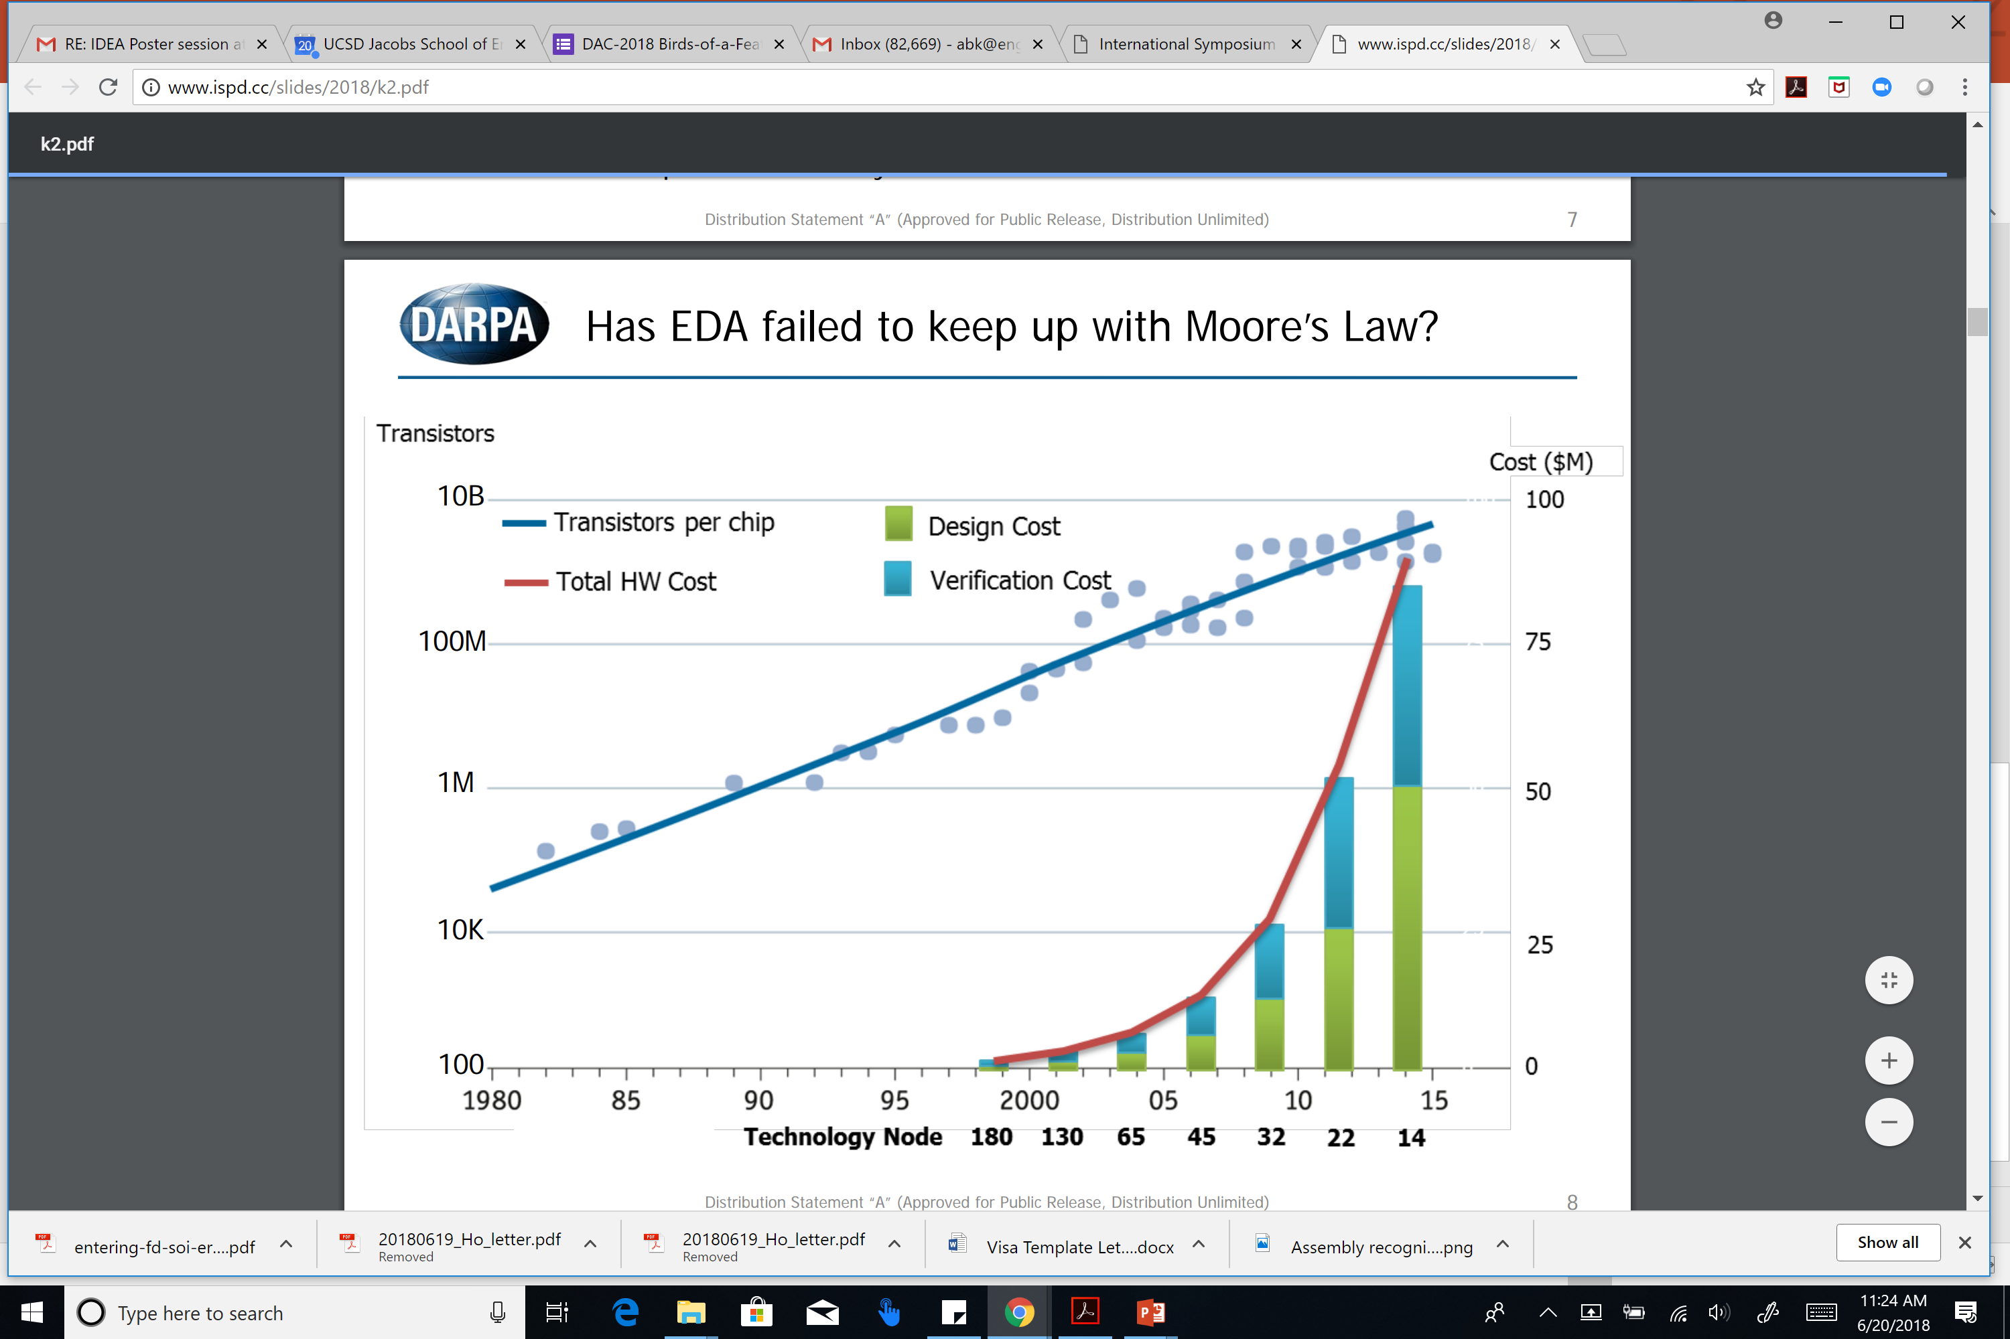
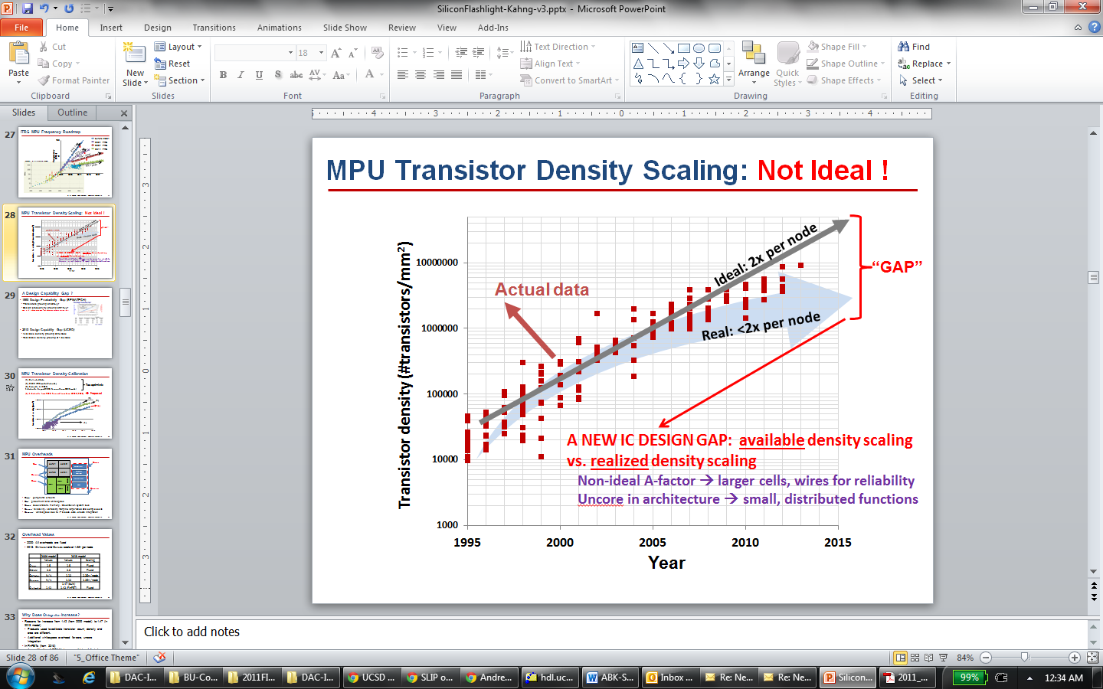
Design Crises: Cost, Expertise, Unpredictability
Design cost: not scaling
Design, process roadmaps not coupled
Figure: Andreas Olofsson, DARPA, ISPD-2018 keynote
Quality: also not scaling
Design Capability Gap
Available density: 2x/node
Realizable density: 1.6x/node
Figure: UCSD / 2013 ITRS
Notes:
When we talk about hardware today, we talk about the crises of hardware design: Cost, Expertise, Unpredictability
Design COST is engineers, licenses, schedule – AND RISK. This slide from Andreas a year ago tells us that wafer cost pretty much always ends up at a nickel or a dime per square millimeter in any process. But this curve at the right means that the cost of designing that square millimeter is out of control. This happens when nothing really ties design technology to Moore’s Law scaling itself.
{CLICK] Compounding this is non-scaling of QUALITY. With every new technology node, yes, you CAN print twice as many transistors in a square millimeter as before – which is AVAILABLE DENSITY … BUT, you CANNOT fit twice as many USEFUL transistors into a given area, going from node to node – and that’s REALIZABLE DENSITY. This DESIGN CAPABILITY GAP goes back well over a decade.

Slide 4
Design is Too Difficult !
Tools and flows have steadily increased in complexity
Modern P&R tool: 10000+ commands/options
Hard to design with latest tools in latest technologies
Even harder to predict quality, schedule
Expert users required
Increased cost and risk not good for industry !
Still have “CAD” mindset more than “DA” mindset
Again: assumes expert users
How do we escape this “local minimum” ?
Notes:
Design itself is too difficult!
A modern P&R tool has more than 10K commands and options.
[CLICK] In latest nodes, tools introduce more complex procs to handle increasing design rule complexity. So outcomes are hard to predict, and expert users are needed. This brings cost and risk that are not good for the industry.
If you remember Makimoto’s wave: What swings the industry from a period of standardization back to a period of customization? Moore’s Law power and performance scaling, or improved design technology and design cost. But both of these drivers are stalled !
[Click] Still living in a computer-AIDED mindset, as opposed to a design AUTOMATION mindset – again assumes expert users.
[Click] So how do we escape this “local minimum”?

Slide 5
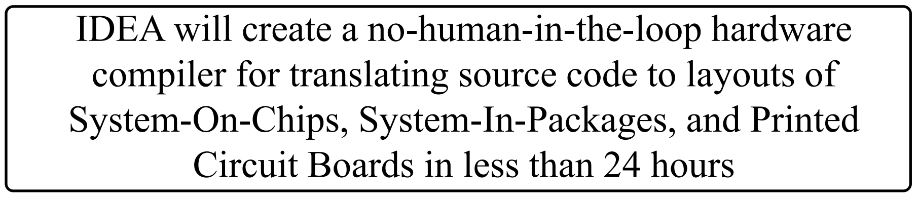
IDEA: No-Humans, 24-Hours
A. Olofsson, DARPA
ISPD-2018 keynote
Part of DARPA Electronics Resurgence Initiative
Traditional focus: ultimate quality
New focus = ultimate ease of use
No humans, 24-hour TAT = “equivalent scaling”
Overarching goal: designer access to silicon
Notes:
One direction is automation, with “self-driving” design tools and flows.
And, the IDEA program aims for Hardware Compilers 2.0 – no humans, 24-hour turnaround time, eventually with zero loss of quality.
CLICK This shifts the focus: FROM tools that can eke out that last picosecond of clock period, TO SELF-DRIVING tools that don’t require any expertise or time to tape out a working chip.
CLICK The industry depends on “one more week brings one more percent” scaling of value – i.e., Moore’s COST AND VALUE SCALING. No-humans, 24-hour self-driving design potentially brings a huge chunk of what the ITRS roadmap called “design-based equivalent scaling”. And it restores the accessibility of silicon to designers.

Slide 6
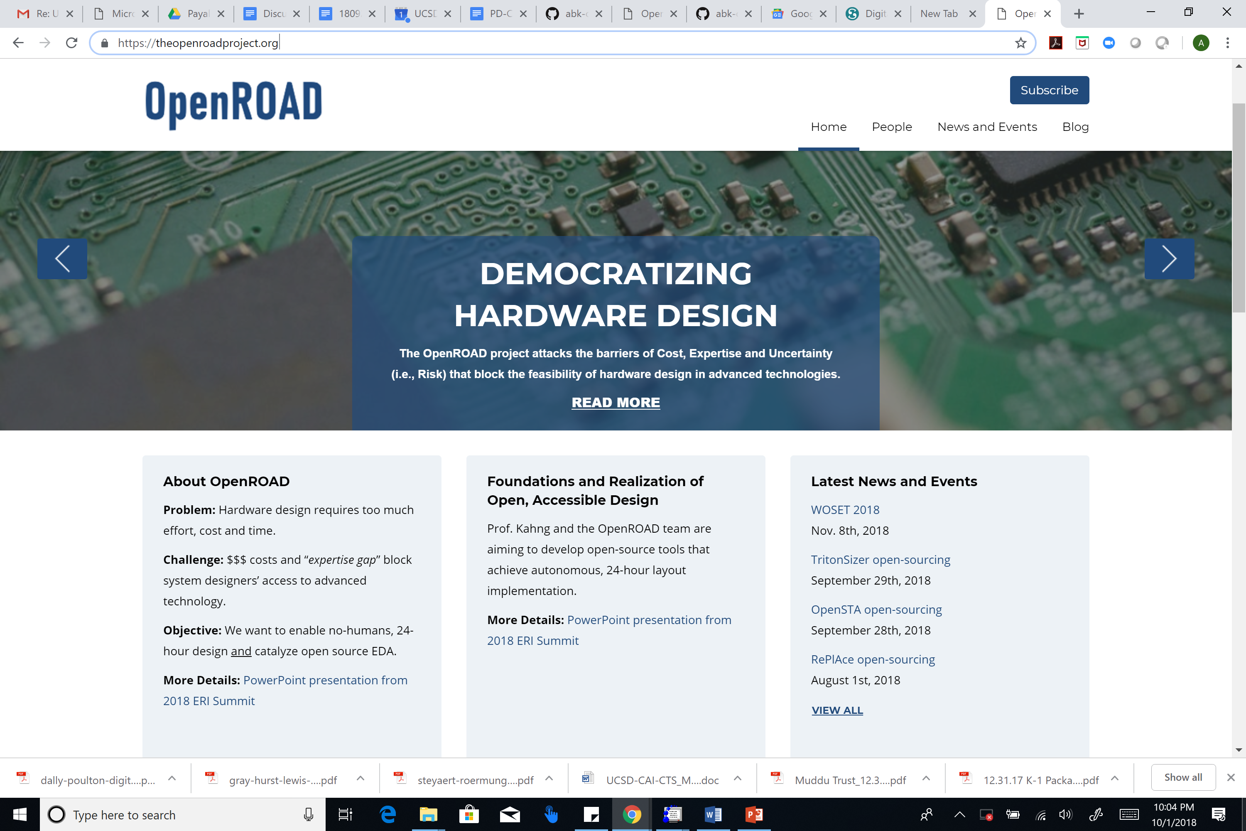







theopenroadproject.org
Notes:
So: OpenROAD is one project in the IDEA program. It aims directly at no-humans, 24-hour design WHILE ALSO catalyzing an open-source ecosystem for tool developers. CLICK There are five universities in the project, plus Qualcomm and Arm.

Slide 7
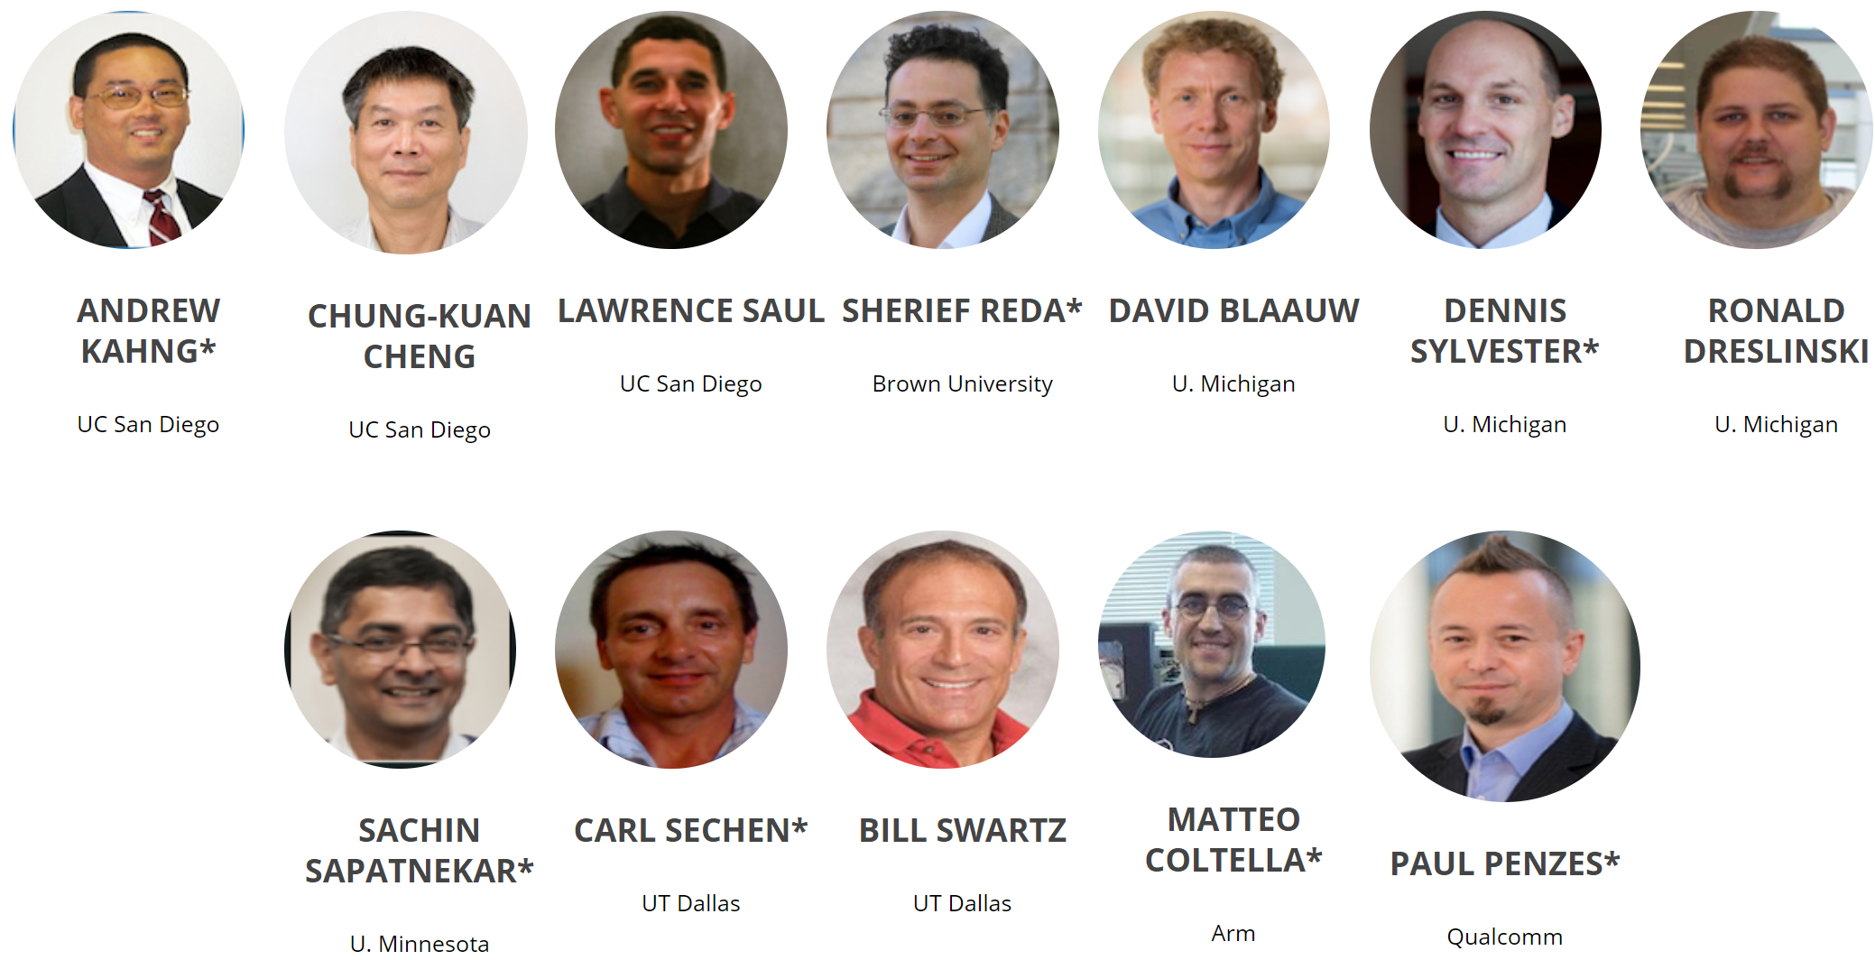
theopenroadproject.org
Notes:
Here are my co-PIs at the universities and the companies – many very well-known faces spanning from layout to analysis, plus SOC design and design methodology.

Slide 8
OpenROAD: A New Design Paradigm
24 hours, no humans – no PPA loss
Extreme partitioning
Parallel optimization
Machine Learning of tools, flows
Restricted layout
Design Complexity
Mindsets
Achieve predictability from the user’s POV
Use cloud/parallel to recover solution quality
Focus on reducing time and effort = schedule, cost
 Quality
 Schedule
 Cost
Machine Learning is CENTRAL to this
Notes:
How will OpenROAD get FROM today’s design complexities TO Design in 24-hours, with no humans, and – eventually – with no loss of power-performance-area (PPA) quality?
We think we have to build three foundational “TECHNOLOGIES”. First, Extreme Partitioning to decompose the design problem into bite-sized chunks. Second, orchestration of parallel and distributed optimization. Third, Machine Learning to model and predict what will happen when a tool is run in a certain way on a given design input. (There’s also “freedoms FROM choice”. Just as self-driving cars will eventually have no steering wheel, we won’t have thousands of Tcl commands. MACHINE LEARNING IS CENTRAL here – partitioning criteria, how to orchestrate, what restrictions …
There are some driving MINDSETS. The USER must see predictability -- whatever goes on under the hood.
Partitioning and restrictions win us time but lose quality. We win quality back with ML and parallel optimization. We never lose sight of time and effort reduction.
*** AGAIN: MACHINE LEARNING is FRONT AND CENTER.

Slide 9
OpenROAD: Project
Initial target: digital IC flow “RTL to GDS”
Open source
No-human-in-loop
Limited “knobs”, restricted field of use
Must replace intelligent humans (partition, floorplan, …)
Notes:
Let me say a bit about what we’re doing.
In our project so far, the priority is the digital IC flow, RTL-to-GDS.
Our deliveries have two FUNDAMENTAL requirements. First, OPEN SOURCE code. Second, NO-HUMAN-IN-LOOP. In other words, self-driving tools in a self-driving, 24-hour flow.

Slide 10
OpenROAD: Project
Initial target: digital IC flow “RTL to GDS”
Open source
No-human-in-loop
Limited “knobs”, restricted field of use
Must replace intelligent humans (partition, floorplan, …)
Notes:
So I’ll touch on about six of the 15 separate tasks in the project. We can discuss further in a telecon, or you can find some more information on our website.

Slide 11
Agenda
Motivations
Initial Target
Notes:
So, our initial target…

Slide 12
Initial Target: RTL-to-GDS Layout Generation
Inputs: .v, .sdc, .lib, .lef
.def, .spef in point tools
config files required
pre-characterizations required
Outputs: post-route .def, timing/power estimates
V1.0 release: June 2020
Verilog + .lib, .sdc, .lef
Logic Synthesis
Floorplan/PDN
Placement
Clock Tree Synthesis
Global and Detailed Routing
Layout Finishing
GDSII
Notes:
Layout generation spans Logic Synthesis through Routing and then layout finishing.
[CLICK] OUR inputs are industry-standard formats - Verilog, constraints, timing/power libraries, physical library views. Additional config files and characterizations are also required.
[CLICK] Output is final routing, plus timing and power reporting.
[CLICK] Today we are about 15 months before v1 release.
We also work on die-package layout flow with Qualcomm, and Professor C-K Cheng at UCSD is leading board place-and-route development (two M.S. graduates of NTU are joining him in a few weeks).

Slide 13
**Internal Design Advisors** + Testcases
University of Michigan subteam = “first customers”, “product engineering”
Provide feedback on “what we want”
Provide feedback on “what we got”
Define sample designs and give calibration feedback on OpenROAD vs. standard EDA tools/flows
Help prioritize features and measure success
Help understand Arm reference system
General TSMC16/Arm tapeout readiness support
Notes:
Let me start with a very important piece: where do we get calibrations and testcases, and who are our “internal AEs and product engineers”?
The team at Michigan acts as the pioneering customers – they provide feedback on what they are looking for to implement their designs, and what they see from the OpenROAD flow.
They assess QOR against what they’ve observed from previous tapeouts, and they also help prioritize features

Slide 14
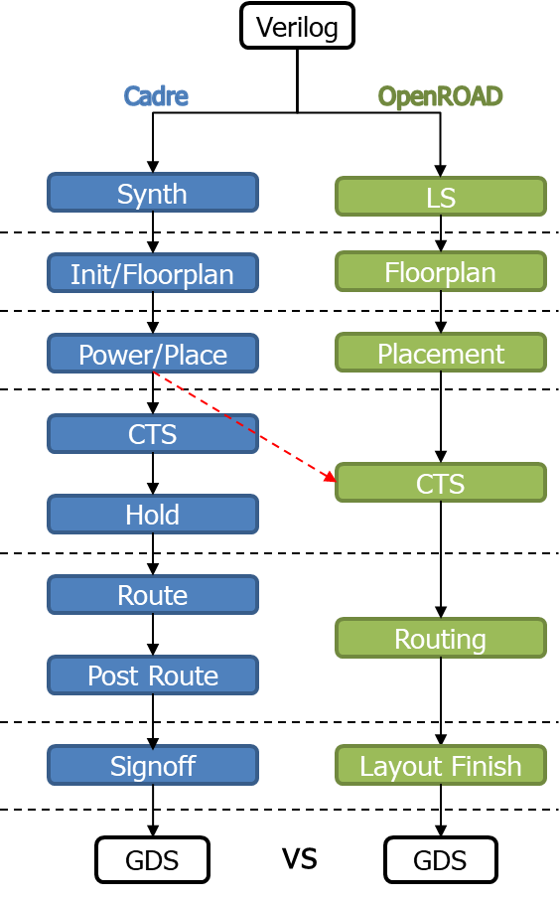
Testcase/Calibration Strategy
Compare flow and results against previous design implementations
Leverage familiar designs and PDKs
Develop and execute testcases of increasing complexity
Scope field of design during flow development
Use footprints to provide design restrictions (process, PPA, design space, etc.)
Also: developing catalog of taped-out, open designs
Notes:
To do this, Michigan is performing fine-grained analysis of the OpenROAD flow against their existing CADRE flow, which they used for a number of taped-out designs.
They’ve developed several testcases of increasing complexity, from small blocks to larger designs.
Eventually, a catalog of validated SOC designs will be usable across the program – and, since it is open, it should be visible to researchers here as well.

Slide 15
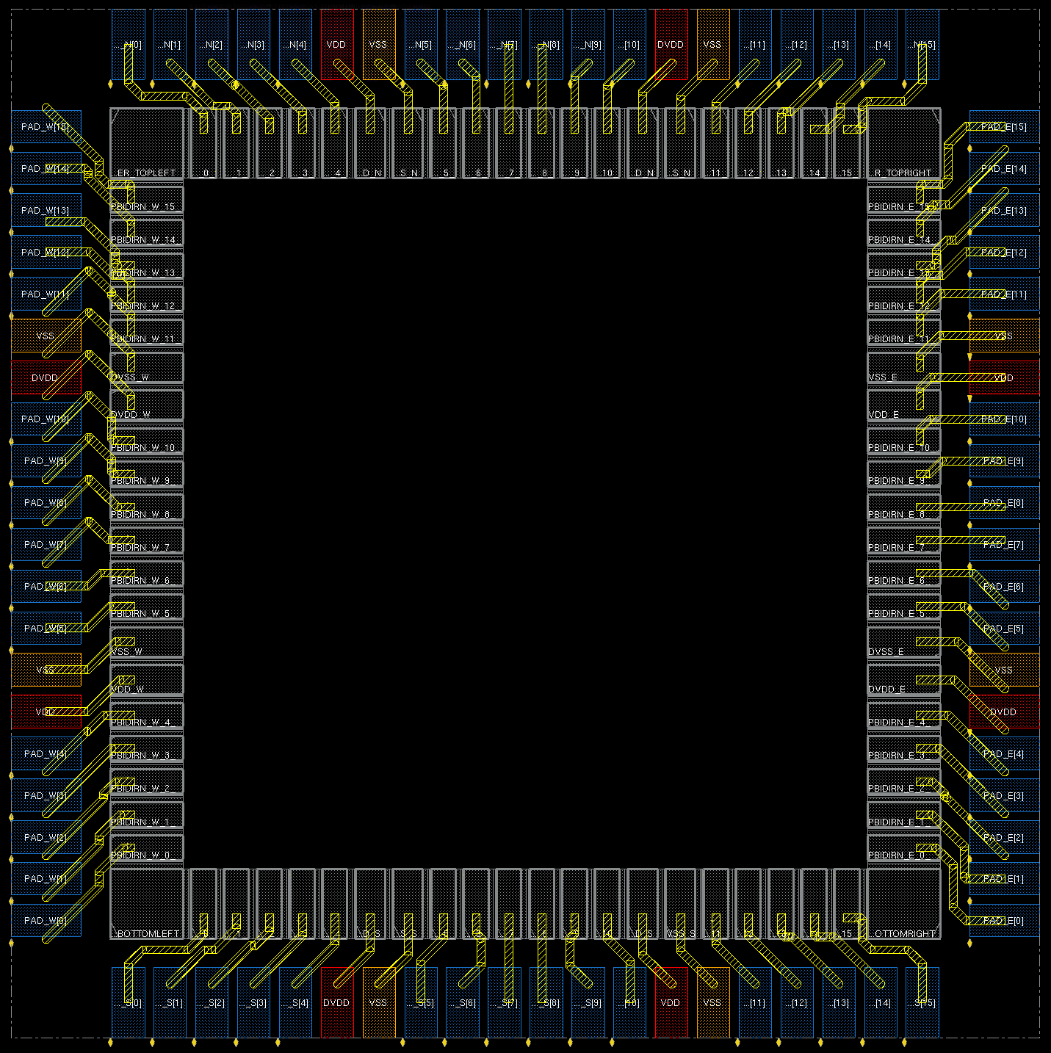
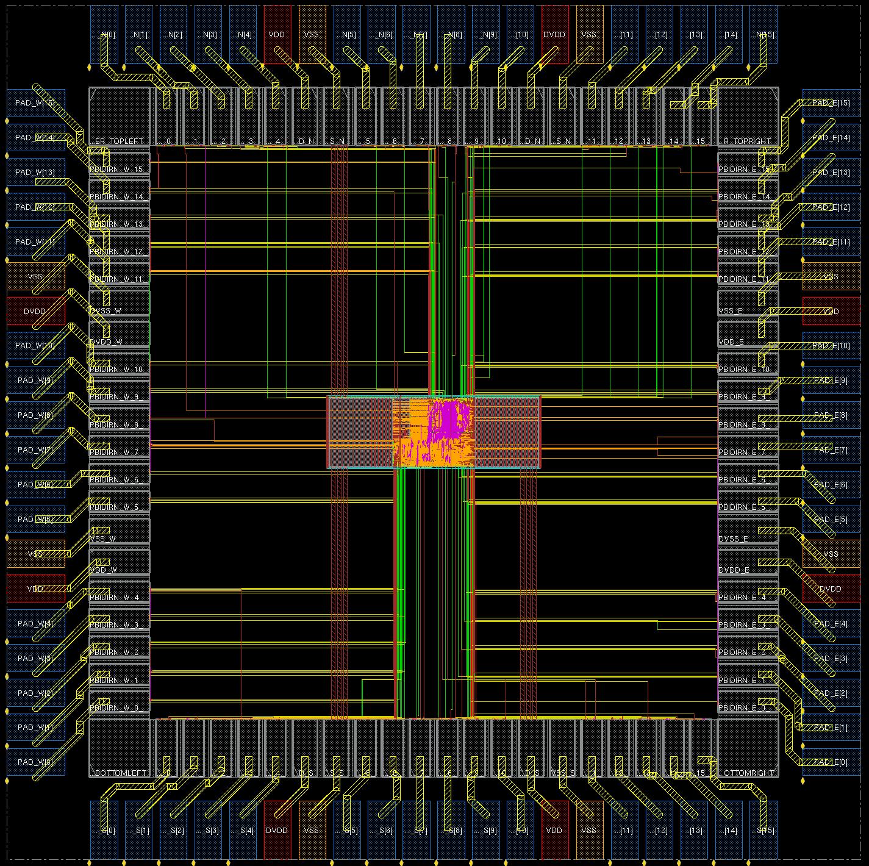
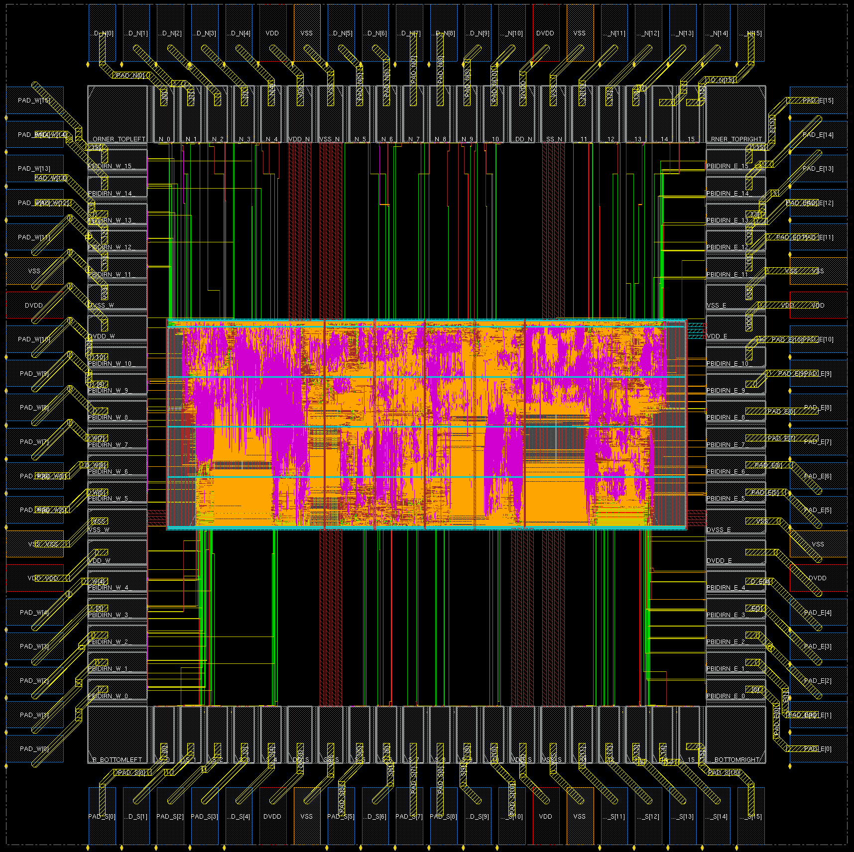
Design Test Cases
Footprints
TSMC16 Process
Arm Cell Libraries
Wire Bond & Flip Chip options
Testcases
“Vanilla Bean”
Small RISC-V based core
12,010 cells
“Coyote”
RISC-V based core (Rocket Chip)
171,697 cells
Primary Targets/Metrics
DRC/LVS Clean
Comparable PPA
Testcases
Footprint
+
Verilog
SDC
OpenROAD
Flow
Notes:
Footprints scope the design space by specifying a process and maximum area to mimic a fab run. Our first couple of footprint options have varying power, area, GPIO, package options
Testcases include a small risc-v based core with about 12,000 cells and a bigger RocketChip with about 170,000 cells
Footprint plus testcase equals a calibration result from Michigan’s flow to guide OpenROAD tool development.

Slide 16
Floorplan / Powerplan
TritonFPlan features:
ILP-based macro packing
Maximizes core area for stdcell placement
Connectivity-aware
TCL-based PDN generation
DRC clean (safe-by-construction config files)
Closely guided by Qualcomm, Arm
Seeded by timing-driven mixed-size RePlAce
Rectangular floorplans, < 100 macros
Current status
Revisiting annealing-based macro packing (B* trees, Parquet)
Adding handling of endcaps, tapcells for TSMC 16FFC
.v from Logic Synth, IP, PDN.cfg, .pins
(+ .sdc, .lef, .lib)
Floorplan/PDN
Floorplan .def with PDN and placed macros
Notes:
Now let me give a few snapshots of the implementation flow, from an internal demo that we had at the beginning of January.
For floorplanning and powerplanning, TritonFPlan has two major components, with methodology guidance from Qualcomm and Arm.
The first component is integer programming-based macro-packing, using rules embedded in config files. This understands netlist connectivity as well as channel, halo, grid-snapping and requirements.
The second component is Tcl-based Power Delivery Network (PDN) Generation, using a safe-by-construction methodology.
Today the field of use is rectangular floorplans, with macro count < 100. Students are working on correct-by-construction handling of endcaps and tapcells in 16 nanometer – and they are revisiting annealing-based macro packing, inspired by the published successes at NTU and Maxeda.

Slide 17
Placement https://github.com/abk-openroad/RePlAce
RePlAce features
Timing-driven (OpenSTA timer integrated)
Mixed-size (macros + cells)
Electrostatics analogy in analytic placement
RePlAce used in:
Physical synthesis
Floorplanning
Clock tree synthesis
Traditional standard-cell placement
BSD-3 License
.def from FP/PDN (+ .v, .sdc, .lef, .lib)
Placement
Placed .def
Notes:
After Floorplanning comes Placement.
The UCSD RePlAce tool handles mixed-size placement and has simple timing-driven net weighting that integrates our open-source static timing engine. RePlAce uses the electrostatics analogy pioneered by Professor Cheng’s group at UCSD.
We use this engine in physical synthesis, floorplanning, post-CTS legalization, and traditional standard-cell placement.

Slide 18
RePlAce: Routability-Driven Placement
Global routing during routability-driven global placement
Routability-driven loop
Notes:
RePlAce also has congestion-driven capability, driven by calculation of a global routing congestion map and application of cell area bloating, under the hood. This picture shows evolution of H and V congestion, and the global placement, as iterations progress from left to right.

Slide 19
Clock Tree Synthesis https://github.com/abk-openroad/TritonCTS
TritonCTS features
Based on Generalized H-Tree approach
DP-based tree topology generation
LP-based buffer placement refinement
Optimizes power and skew
One-time characterization needed of buffer library, buffered interconnect delay/slew
Early validations: TSMC16, ST28
BSD-3 License
Placed .def
.cfg file, pre-char LUTs
(+ .sdc, .lef, .lib)
CTS
Post-CTS .v, .def (clock buffers legalized by RePlAce)
Notes:
For clock tree synthesis: TritonCTS is public on GitHub. It does clock-tree synthesis based on dynamic programming for topology generation and linear programming for buffer placement refinement. It optimizes along the skew-power tradeoff curve, and for this it needs a one-time library and technology characterization. Some early validations have been in 16 and 28 nanometers.
.

Slide 20
TritonCTS Scaling
TritonCTS top level for Michigan VanillaBean TSMC 16FFC, 9T
Design | # Sinks | Time (s)
VanillaBean | 2067 | 11
Coyote | 40327 | 400
Notes:
For those two Michigan examples, TritonCTS produces a topology with 174 clock buffers for VanillaBean in 11 seconds. For Coyote, TritonCTS process a topology with around 5000 clock buffers in 400 seconds.

Slide 21
Detailed Routing
TritonRoute: An integer linear programming-based router
Current status (originated from ISPD18 winning router)
Track assignment routing with pin access
Support of TSMC16 design rules
LEF58_SPACING
LEF58_SPACINGTABLE
LEF58_CUTCLASS
Ongoing Work
Local net routing
TritonRoute used in:
Clock tree routing
Signal net routing
Outreach
ICCAD19 Global Routing contest
(co-organized with Mentor Graphics)
→ OpenROAD provides up to 4X prize bonus for open-sourcing
Placed .def
+ ISPD18 route guides (+ .v, .sdc, .lef, .lib)
(Detailed) Routing
Routed .def
Notes:
Routing is one of our toughest challenges. TritonRoute is a integer linear programing-based router. Currently, it starts with a global routing solution and performs track assignment considering major TSMC16 design rules.
In their ongoing effort, Lutong Wang and Bangqi Xu are working on local routing strategies and comprehending the remaining design rules in TSMC16.
They are also co-organizing with Mentor Graphics the ICCAD19 LEF/DEF Based Global Routing Contest.
This is part of our outreach to the community – in this case, there is an open-source bonus of up to 4X the default prize, available to each of the winning teams.

Slide 22
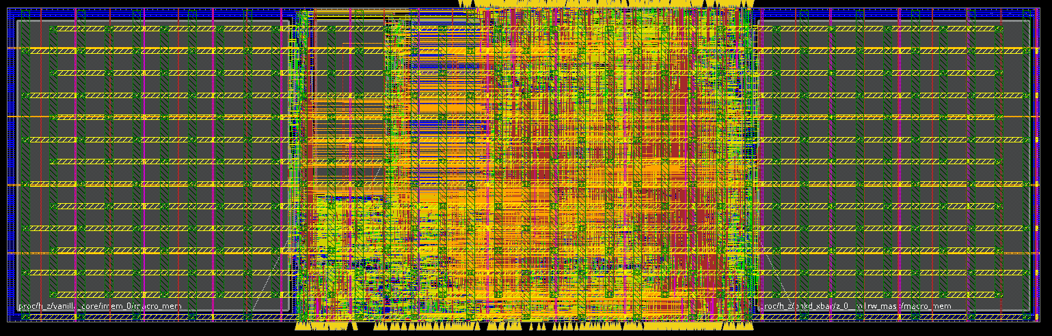
TritonRoute 16nm DRCs
DRC comparison (evaluator: Innovus)
Routed design
DRC Type | TritonRoute (short only) | TritonRoute (short + spacing) | Innovus
Cut Spacing | 11522 | 915 | 0
Metal EOL Spacing | 8724 | 1072 | 0
Parallel Run Length Spacing | 4364 | 355 | 0
Notes:
This TABLE from the end of last year shows consideration of three types of major spacing rules.
TritonRoute considering only short rules yields thousands of design rule violations for each DRC type. TritonRoute considering short AND spacing rules yields hundreds of violations for each DRC type. And while the router continues to improve, we also explore more routing-friendly cell placement and pin placement.
Thanks to Yufeng for pointing out the growth of DR types from 20 up to 45nm, to 120 in 16/14, to 200 in 7nm… This is not easy.
This is incredibly hard: right now, I’d guess there are six tools on the planet that can route 16/14 clean (NOT 100% of the time, of course!), and each has hundreds or thousands of R&D years invested.

Slide 23
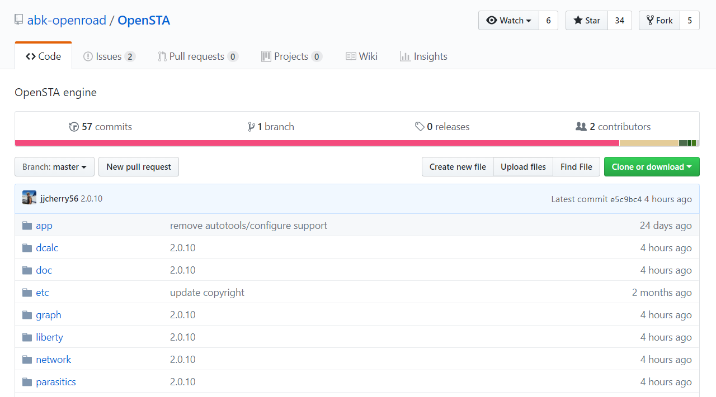
Static Timing Analysis https://github.com/abk-openroad/OpenSTA
OpenSTA: open-sourced static timing analysis tool
Developer: James Cherry (Parallax Software)
Tested with ASAP7, GF14, TSMC16, ST28, etc.
GPLv3 license
Notes:
Our project’s OpenSTA release is an open-sourced version of the commercial Parallax timer. This is definitely one of OpenROAD’s highlights so far.
The developer, James Cherry, has added Arnoldi delay calculation, power reporting and other enhancements since the original release. This timer provides standard timing report styles and solid coverage of SDC constraint types.

Slide 24
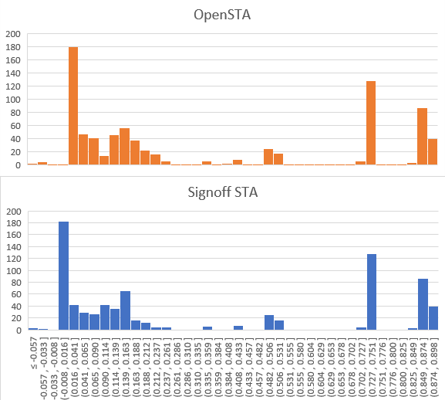
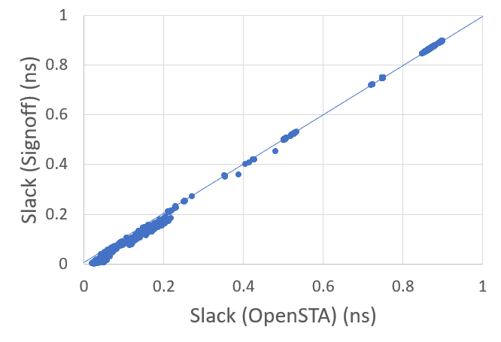
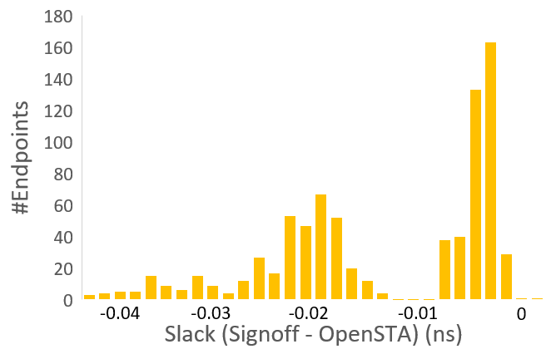
OpenSTA Slack Accuracy, Pessimism
aes_cipher_top (28nm, 12T, clkp=1000ps)
aes_cipher_top | WNS (ps) | TNS (ps)
Signoff STA | -61 | -289
OpenSTA (arnoldi) | -57 | -314
Notes:
Here are slack histograms, WNS and TNS for a commercial signoff timer and for OpenSTA on a small block. From our studies, we see this as a very promising foundation for signoff and optimization in our tool chain.
OpenSTA is integrated into placement, gate sizing and physical synthesis, with more to come.

Slide 25
OpenROAD: Project
Initial target: digital IC flow “RTL to GDS”
Open source
No-human-in-loop
Limited “knobs”, restricted field of use
Must replace intelligent humans (partition, floorplan, …)
Notes:
So that was a sampling of SIX out of the FIFTEEN tasks in OpenROAD – and, we’re one of about a dozen projects in IDEA.
Next, recall that the first requirement of our project delivery is OPEN SOURCE code. Let me explain why this is so critical to the future of our field, and our industry, and the semiconductor ecosystem.

Slide 26
Agenda
Motivations
Initial Target
Open Source
Notes:
So, WHY open source?

Slide 27
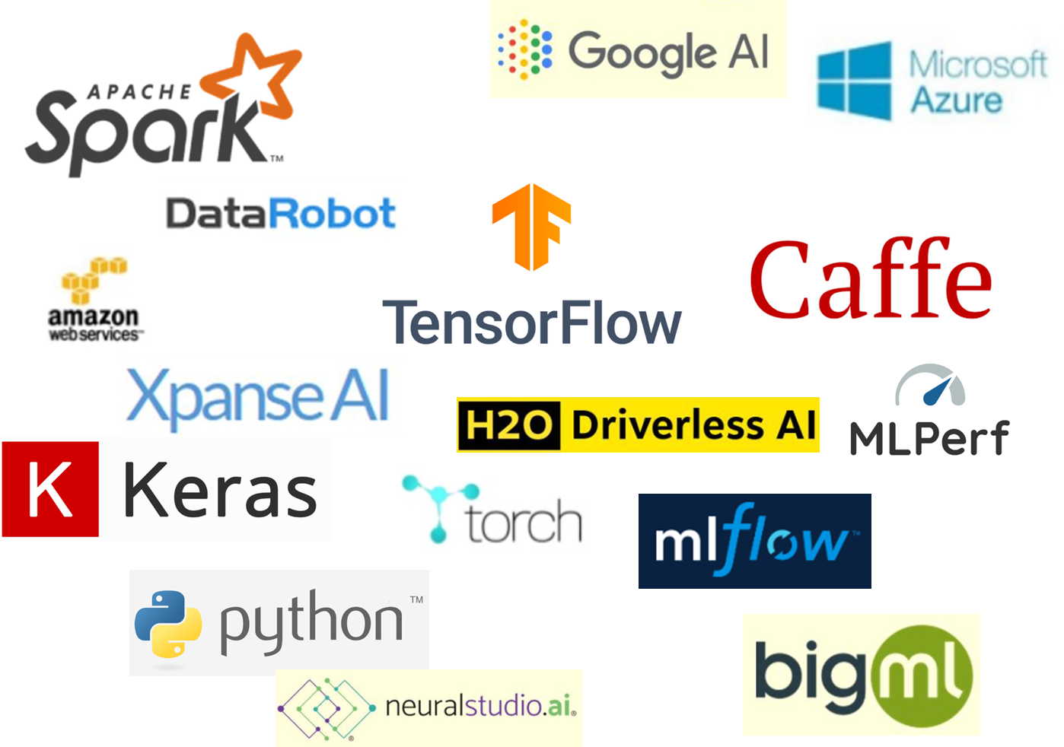
Obvious Reasons
Clarity, better science
Leading edge becomes visible and well-defined
Advances are verifiable: no more “irreproducible results” !
Avoid reinventing wheels
Students don’t waste months trying to reconstruct papers
Field advances more rapidly
Strong correlation with maturity, health of field
Look at AI / ML, computer vision …
Strategic advantages to researchers and companies alike
Notes:
Clarity – research is principled and verifiable.
Don’t waste time! People are precious in our world – enough are going to Facebook without making research life unnecessarily tough or impossible!
As Andreas mentioned: mature fields do this, and flourish !

Slide 28
Corollaries
More design technology productivity, innovation
Understanding of algorithms, tools, benchmarks, results
Helpful when R&D tends to focus on narrow optimizations
Helpful when EDA engineers are in short supply !
EDA research becomes more attractive
Less backward, less wasteful of students’ energy
Citations, metrics of impact won’t suffer
ORION2.0 (DATE09, TVLSI12) >1000 citations
B*-trees (DAC00) 588 citations
Capo (DAC00) 433 citations
+ many more downloads than citations
Notes:
Corollaries: Our field moves faster. It becomes more attractive.
And we benefit too. Open source – for me, or for Yao-Wen – has clearly brought citations and downloads and impact. Hard to say why this could have been in any way a mistake on our part.

Slide 29
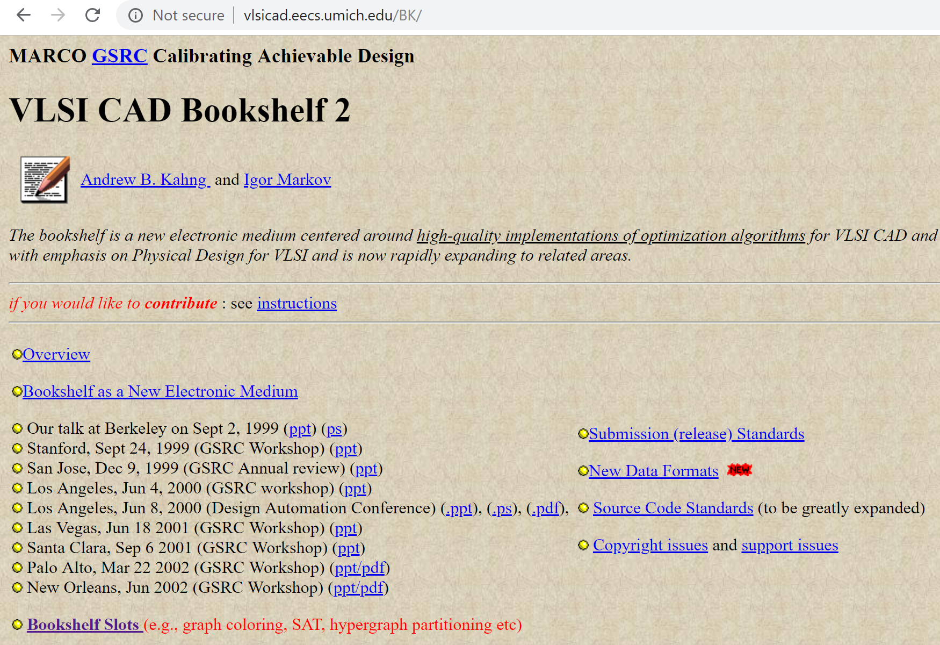
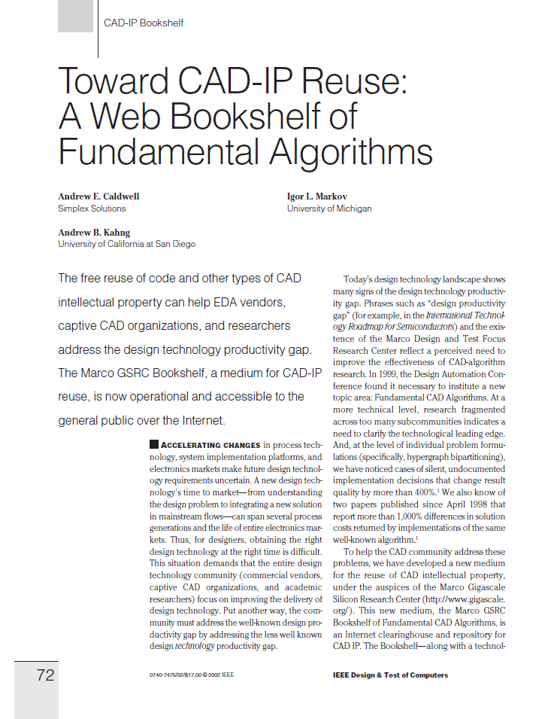
“Bookshelf” 20 Years Ago: Not Much Traction
Not much progress on design technology, research productivity, growth of field, …
But, still using Bookshelf benchmark formats ☹
Notes:
20 years ago, we tried this.
And it didn’t “take root”. Culture didn’t change. (Of course, many students and research efforts benefited greatly from the tools such as Capo or Parquet or DME that were open-sourced in the Bookshelf.)
Looking back, there’s some positive legacies and lessons learned from the Bookshelf – as well as one big negative:
Unfortunately, our field is still using the formats that I and my students came up with at UCLA 20 years ago……. (as a result, in some ways academic research is stuck in a parallel, non-real-world universe even now…)

Slide 30
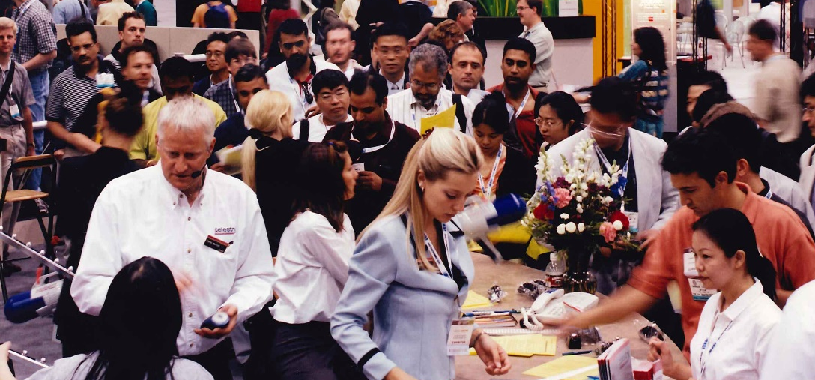
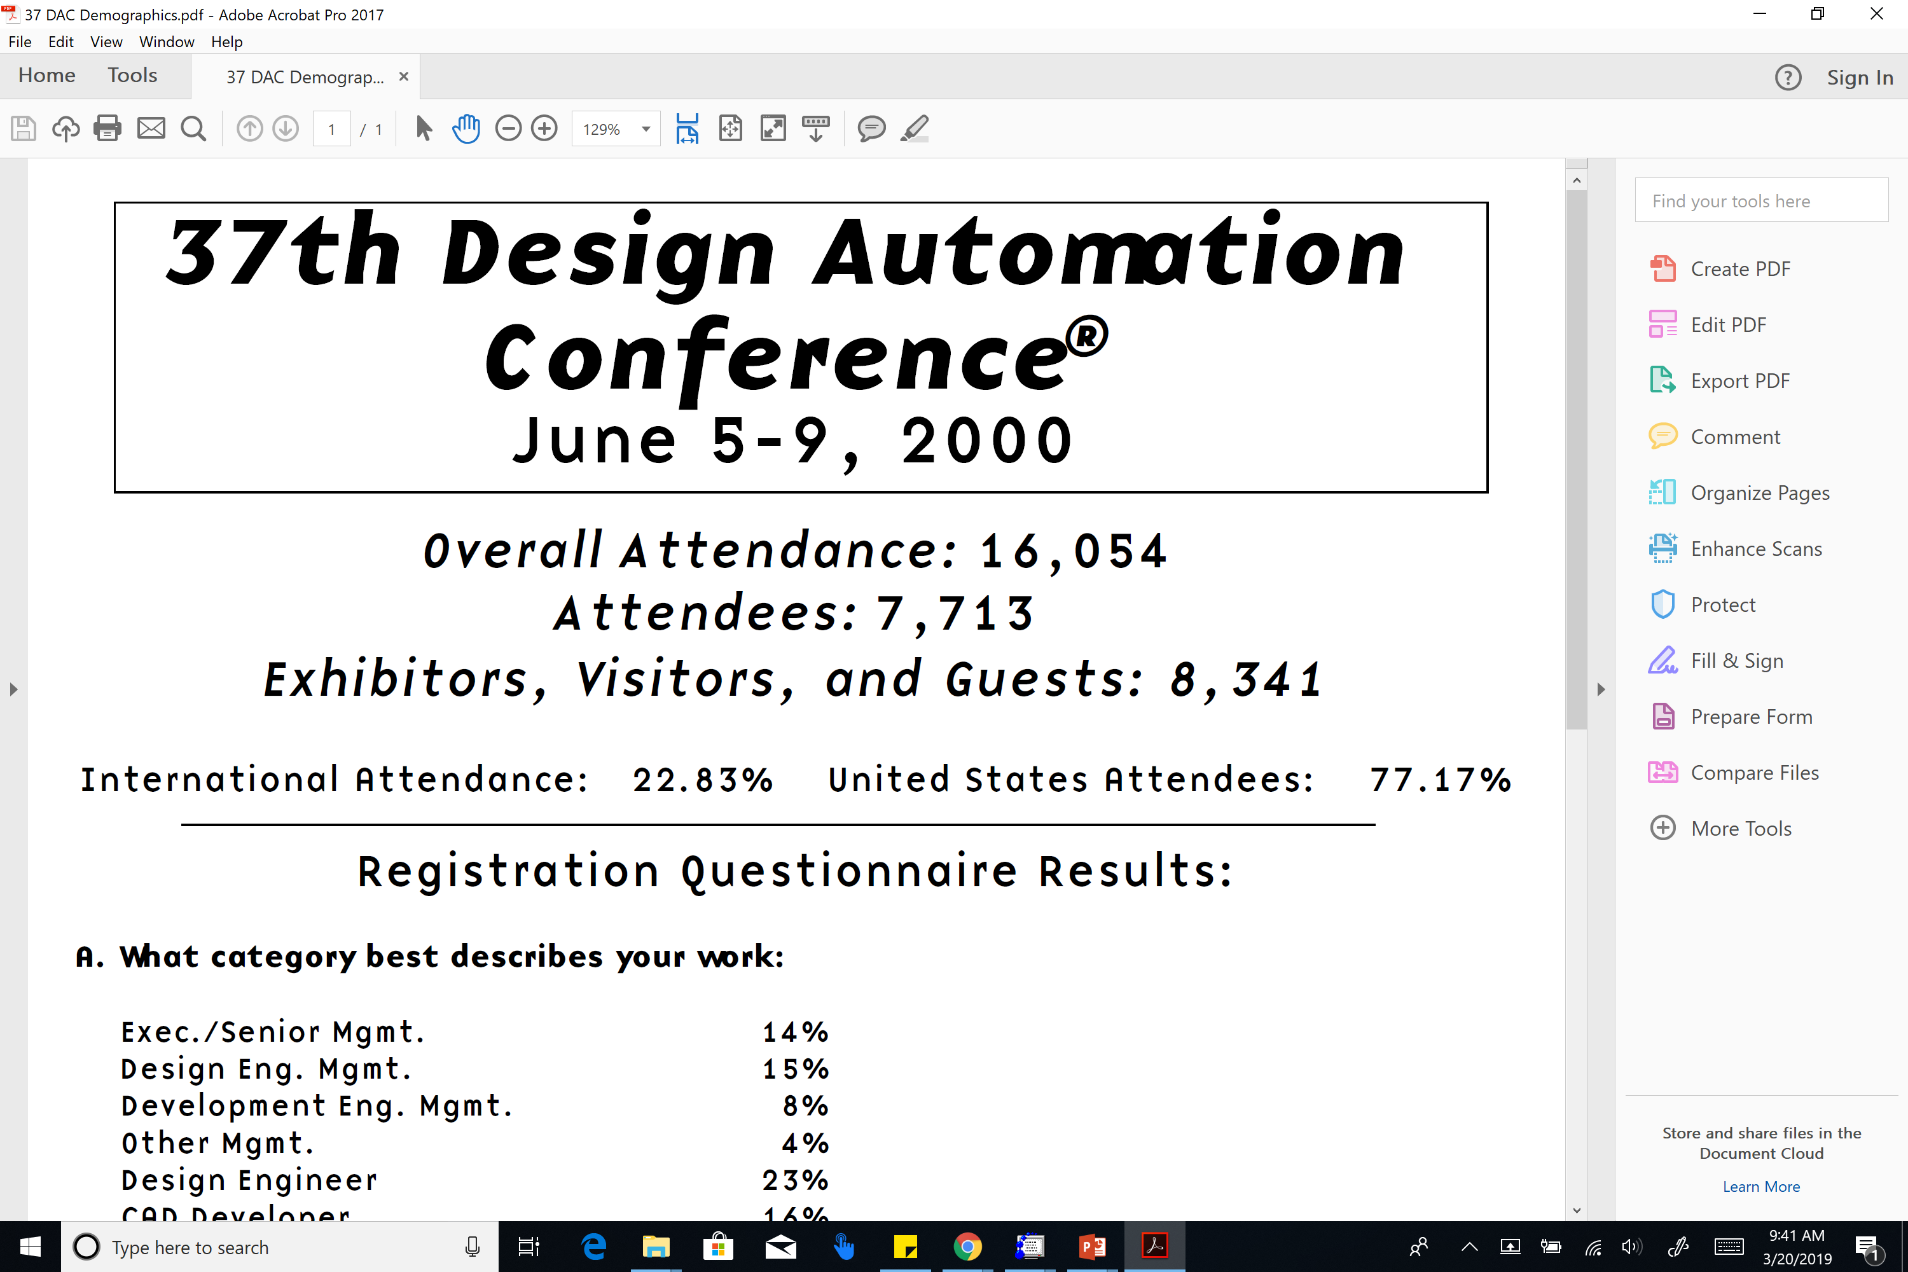
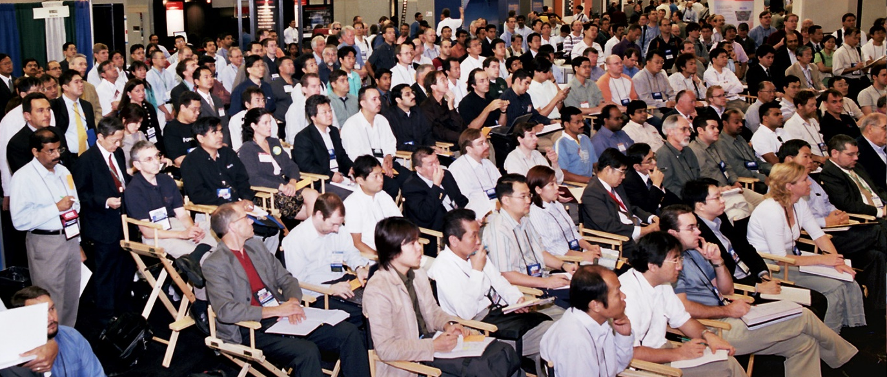
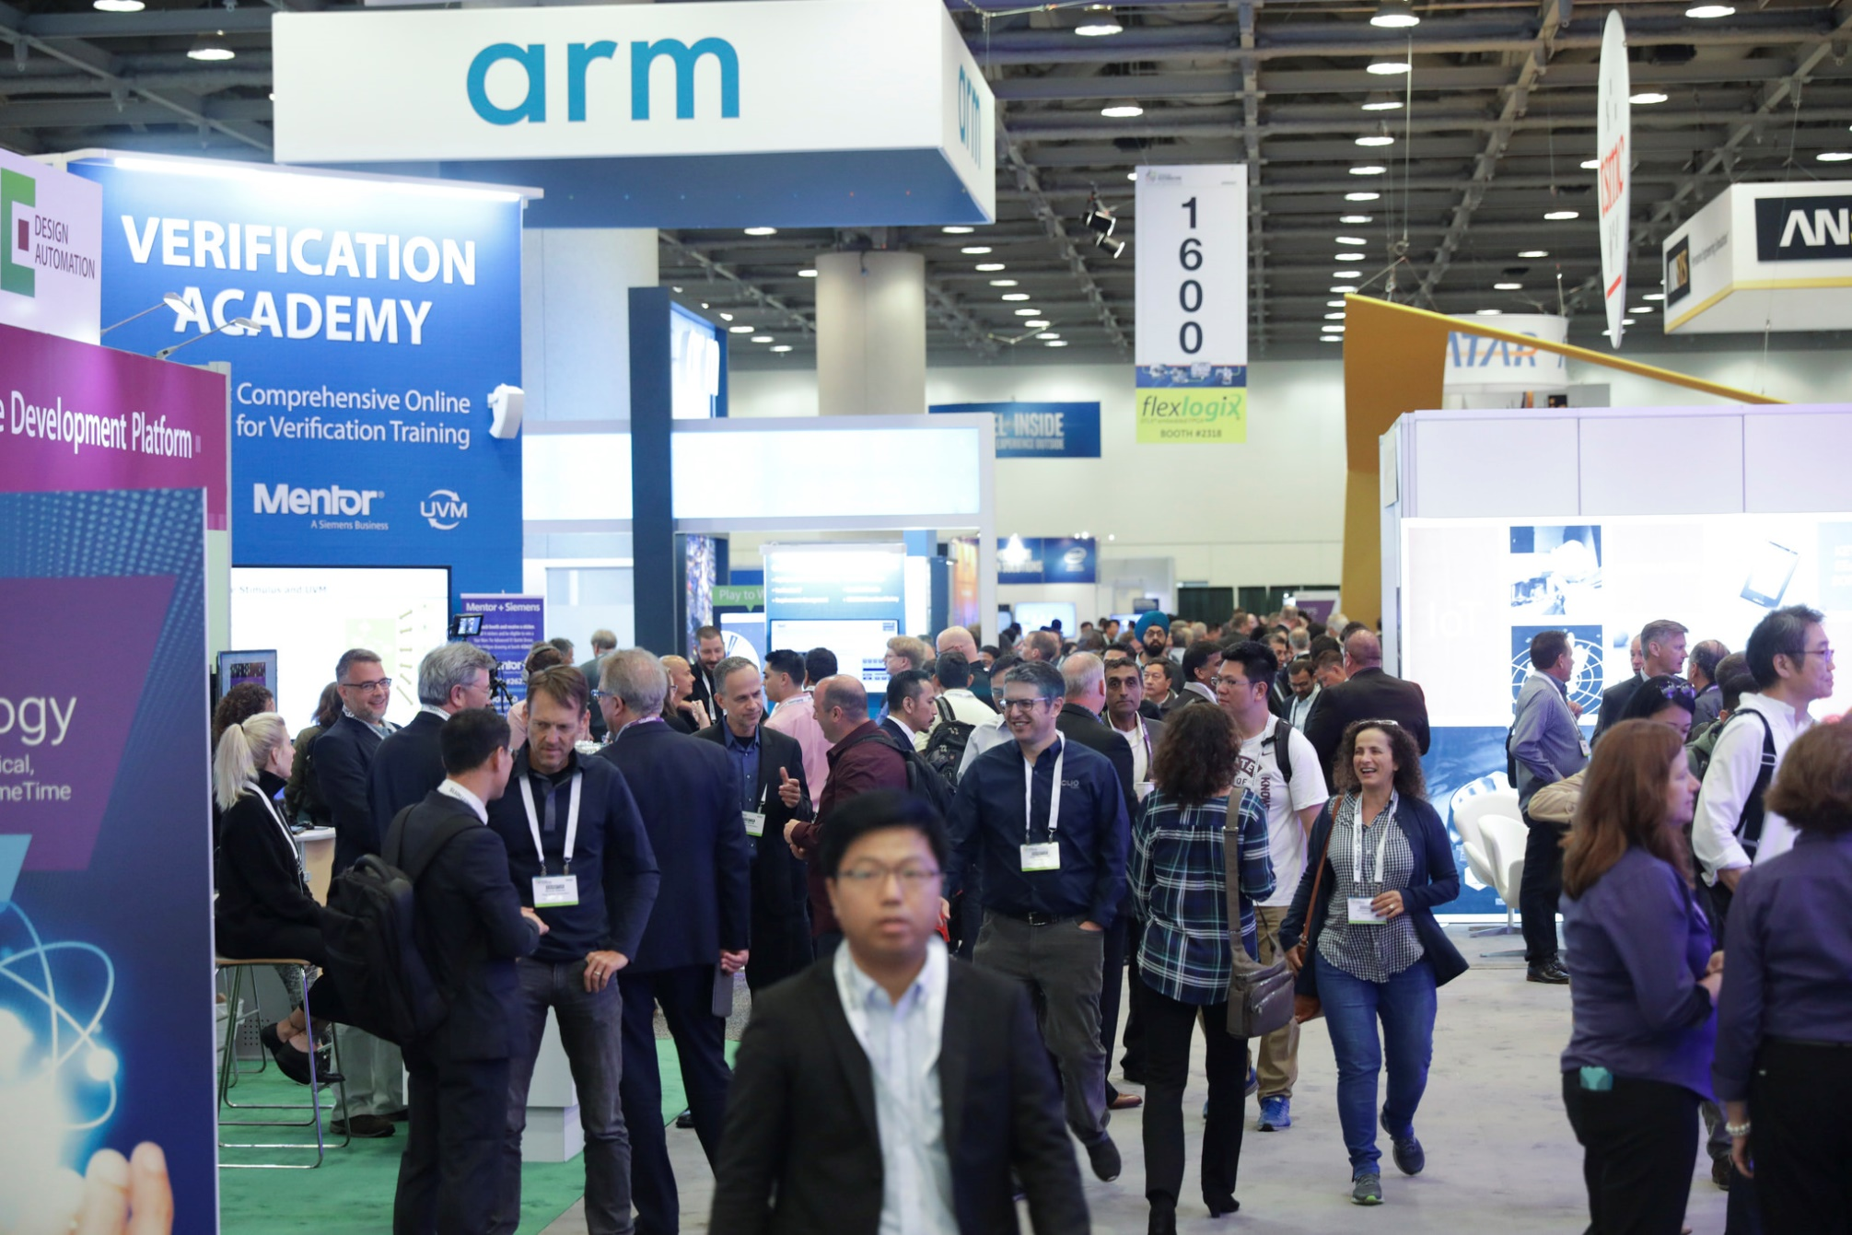
How Has This Been Working Out For Us ?
Notes:
How’s this been working out for us?
Not well.
Which picture do you think is from a recent DAC ?
Chronological order, top to bottom.
Bottom picture (last year) is the one with lots of gray hair.
[CLICK] And here are attendance statistics from DAC-2000. We’re far from this today.
It’s time for EDA to rethink some culture changes, in my opinion…

Slide 31
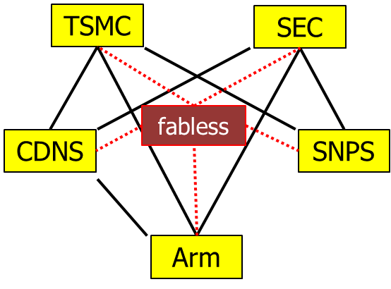
Why Open Source is Critical Now
Extreme consolidation: 2 fabs, 2 EDA companies, at most 3 standing in GPU, FPGA, Mobile SOC, …
Design technology is higher-value
Private-label EDA is inevitable
One of few levers for differentiation
Foundry: protect IP leakage, roadmap better than current DTCO mechanisms
Fabless: protect key SOC methodology, design innovation that otherwise leaks to competitors
EDA: more useful research, in more usable forms
Academia: see previous slides (and, engage … or not)
Notes:
Personally, I feel that EVERYONE in this room should want to see OPEN-SOURCED EDA RESEARCH.
Why is this so critical?
Extreme consolidation.
Everyone fights intense wars with exactly the same weapons? (Fab processes, 3rd-party IPs, EDA tools…) → Everyone claims that “We will win because of our people and our culture” – WRONG.
Private-label EDA is inevitable, and this can REALLY benefit from open source glue and engines.
FOUNDRY:
FABLESS:
EDA: consumable, turnkey research results from academia
ACADEMIA: I’ve explained this, and from my past 20 years of open-sourcing, I do understand that people engage or not – it’s after all a personal thing. For my part, I believe it is the right path.

Slide 32
Also: “Paying It Forward”
EDA began with open source: SPICE, SUPREM, MAGIC, ESPRESSO, FASTCAP, MIS/SIS, …
Many open-source tools continue to be developed today
Tool | Provider | License | I/O Format
yosys | Clifford Wolf | ISC (BSD-2) | Industry
Parquet | UMich |  | Academic
NTUPlace 2.0 | NTU |  | Academic
NTHU GR | NTHU |  | Academic
Qrouter | Tim Edwards | GPL 2.0 | Industry
OpenTimer2.0 | UIUC | MIT | Industry
Rsyn | UFRGS | Apache 2.0 | Industry
We want to see critical mass, culture of FOSS in our domain
Tool | Provider | License | I/O Format
OpenSTA | Parallax | GPL 3.0 | Industry
RePlAce | UCSD | BSD-3 | Industry
TritonSizer | UCSD | BSD-3 | Industry
TritonCTS | UCSD | BSD-3 | Industry
UTD-BoxRouter | UTD | BSD-3 | Industry
Notes:
I think of this as just paying it forward – the right thing to do for so many reasons.
So, OpenROAD is open-sourcing everything, by our contract and because we wanted to anyway.

Slide 33
OpenROAD: Project
Initial target: digital IC flow “RTL to GDS”
Open source
No-human-in-loop
Limited “knobs”, restricted field of use
Must replace intelligent humans (partition, floorplan, …)
Notes:
Now let me recall the SECOND of our two FUNDAMENTAL requirements: NO-HUMAN-IN-LOOP. In other words, self-driving tools in a self-driving, 24-hour flow. Which means MACHINE LEARNING.

Slide 34
Agenda
Motivations
Initial Target
Open Source
Machine Learning
Notes:
We’ve heard every speaker mention Machine Learning. Where does Machine Learning fit – inside, and around, self-driving IC layout tools?

Slide 35
ML in IC Design: Not Just Pictures …
NHIL / self-driving IC design demands new thinking
3-week SP&R&Opt run is NOT like playing chess!
Design lives in a {servers, licenses, schedule} box
Distributions of outcomes matter cloud, parallel
A “stack of models” is mandatory: Predictions of downstream outcomes are also optimization objectives
Still uncharted road to self-driving tools and flows
How do we overcome “small, expensive data” challenges?
Standards: Learning comes from {design + tool + technology}, all of which are highly proprietary
Need mechanisms for IP-preserving model sharing
Research community must lead efforts to solve these challenges
Notes:
Self-driving hardware design at advanced nodes is a new and fascinating challenge.
Learning about IC design is not like learning about cat faces versus dog faces, or playing chess. Every chip is new. Playing the IC SP&R game takes two weeks, not two seconds.
We have to design within a box of servers times licenses times schedule.
At the same time, only one thread needs to survive and deliver a solution. So, we care a lot about distributions and expectations.
And we’ll need a “stack of models”: any prediction of downstream outcomes also serves as an optimization objective for some solver higher up in the implementation chain.
CLICK Certainly, there are “small data” challenges. And, when learning involves a Qualcomm design and a Synopsys tool on a TSMC process with Arm cores – who can actually access and benefit from this learning? It’s on the research community to find a way past these challenges.

Slide 36
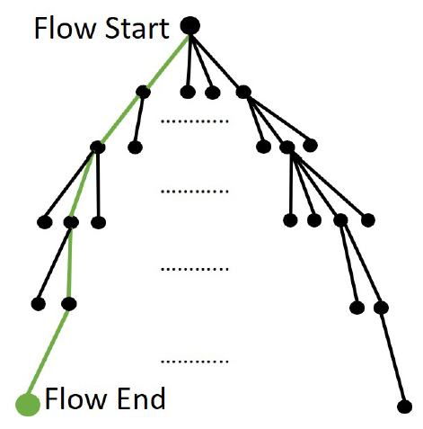
4 Stages of ML to Reduce Design Time, Effort
Four Stages of Machine Learning
Mechanization and Automation
Orchestration of Search and Optimization
Pruning via Predictors and Models
From Reinforcement Learning through Intelligence
Huge space of tool, command, option trajectories through design flow
Notes:
The hope is for machine learning techniques to chip away at today’s enormous time and effort challenge in hardware design. This challenge comes from having a HUGE space of possible trajectories – just through the implementation flow, what constraints, what floorplans, what placer or router settings, and so on.
[CLICK] I usually say that we’ll see four main stages of how time and effort reductions will be achieved by machine learning.– FROM mechanization and automation ultimately TO intelligence. [CLICK] The last three are part of our research in OpenROAD. And [CLICK] let me give the flavor of what I mean by Modeling and Prediction – and potential benefits.
[[These stages are orthogonal to levels of self-driving capability …]]

Slide 37
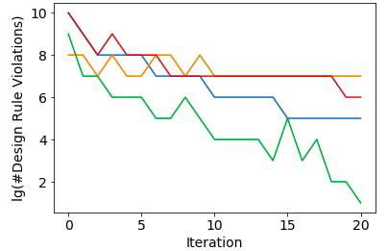
Example: Predicting Doomed Runs
Today’s context: long P&R tool runs
Approach: track and project metrics as time series
E.g., use Markov decision process (MDP): “GO” vs. “STOP” strategy card to terminate “doomed runs” early
Shown: 4 example progressions of #DRVs (commercial router)
Notes:
Simple dream: PREDICT WHETHER A TOOL RUN IS GOING TO FAIL.
An OBVIOUS application is that detailed router, which take a week to get through its 20 iterations. (And there’s doomed floorplans, doomed timing closure runs, and so on.)
Can we IDENTIFY which runs – which are like TIME SERIES - are DOOMED TO FAIL ?
Here, the LOG of the number of Design Rule violations is on the Y-AXIS. The iteration count is on the X-AXIS. Can we LEARN to kill the red and orange runs early, but let the green run finish?
So if you look at various talks on my website, you can see some slides on use of Markov decision process models --- GO versus STOP at a given tool iteration – for this kind of application.

Slide 38
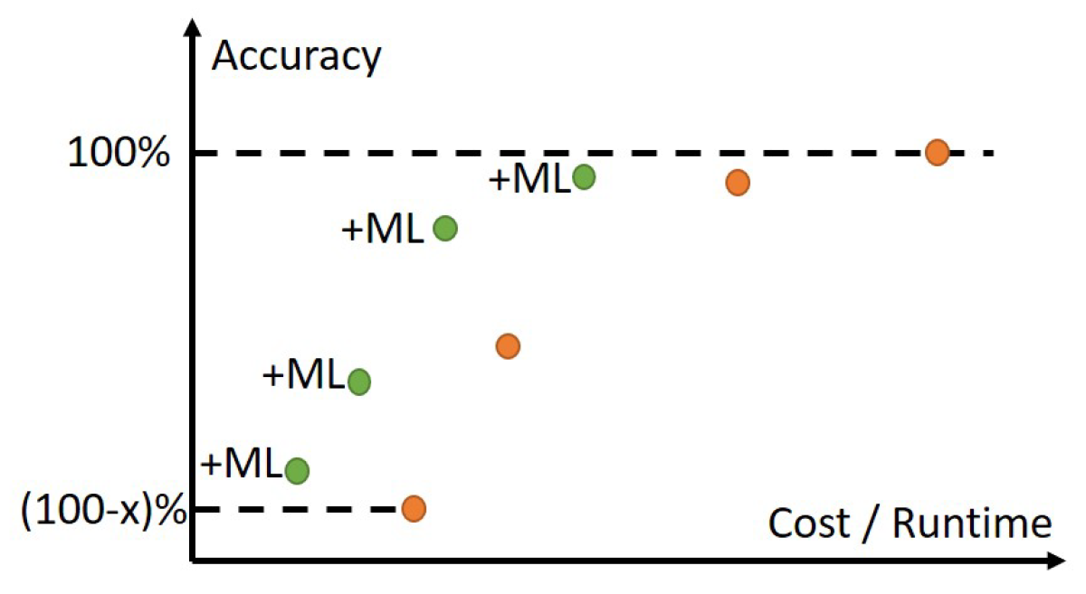
Obtaining Golden From Non-Golden
ML shifts the Accuracy-Cost
Tradeoff Curve (for free) !
Notes:
Another important context for modeling and prediction is in the ANALYSIS realm, where the ORANGE dots show the traditional COST (X-axis) versus ACCURACY (Y-axis) tradeoff curve, for instance, going from 3D field solvers at the top right to piecewise analytic models to first-order estimates, etc. Methodologists, DTCO folks, library teams, signoff teams, design engineers all figure out how to pick and choose from the orange points during IC design.
Quite a few of my group’s works have focused on using Machine Learning to create GREEN tradeoff points: essentially, getting off the ORANGE curve and gaining accuracy for FREE. That’s the GREEN[CLICK] arrow here. This is ALSO a type of improved modeling and prediction that leads to fewer loops, and less margins.

Slide 39
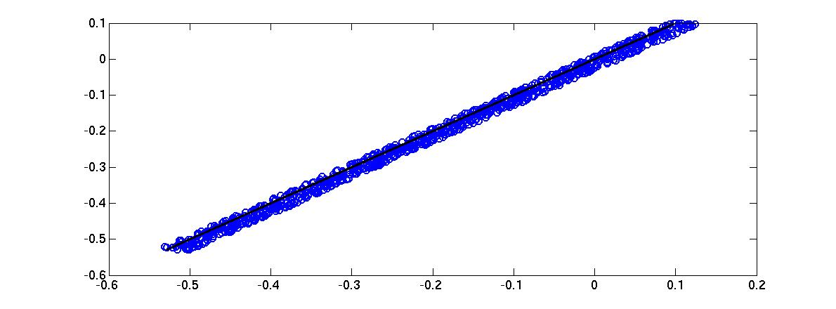



Example: ML-based Timer Correlation
DATE14, SLIP15
Outliers
(data points)
INCREMENTAL
If
error > threshold
New
Designs
Train
Validate
MODELS
(Path slack, setup time, stage, cell, wire delays)
Test
Artificial
Circuits
Real
Designs
ONE-TIME
BEFORE
AFTER
T₂ Path Slack (ns)
ML Modeling
31 ps
123 ps
~4$×$reduction
T₁ Path Slack (ns)
Notes:
Five years ago at DATE, we showed how you could essentially take reports from a cheap timer, and turn them into reports from an expensive timer.
Regarding that discussion about “data”: a standard methodology that we use involves MODEL TRAINING on data from small artificial circuits, minimizing both mean-squared error and range of errors.
Validation is on artificial circuits and real designs; the blue dotted box is a one-time effort.
New designs can have circuit configurations that expose errors in current fitted models. So, with any slack error above a threshold, we use the outlier datapoints to refine our models. This “incremental modeling” flow is in the red-dotted box.
The end result – FOUR X reduction in timer miscorrelation – is shown in the bottom plots. And we have a number of proof points with this flavor.
[[Parameter list:
(i) incremental delay in non-SI mode; (ii) transition time in non-SI mode; (iii) clock period; (iv) resistance; (v) coupling capacitance; (vi) ratio of coupling-to-total capacitance; (vii) toggle rate; (viii) number of aggressors; (ix) ratio of the stage in which the arc of the victim net appears to the total number of stages in the path; (x) logical effort of the net’s driver; and (xi), (xii) the differences in max (respectively, min) arrival times1 of the signal at the driver’s output pin for the victim and its strongest aggressor.]]

Slide 40
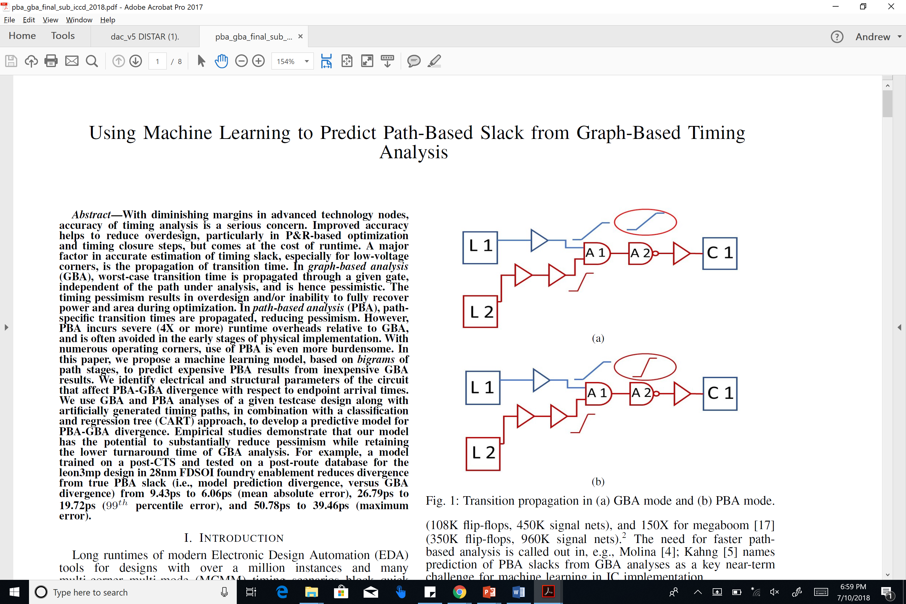
Example: Predicting PBA from GBA
ICCD18
PBA (Path-Based Analysis) is less pessimistic than GBA (Graph-Based Analysis)
But, can have MUCH more expensive runtime !
ML task: Predict PBA timing from GBA timing
→ Improved quality of results in P&R, optimization
→ Less-expensive timing analysis
GBA Mode
PBA Mode
Notes:
We’ve used ML to predict expensive path-based analysis from cheaper graph-based analysis. As shown here, GBA propagates worst slews that might not apply to a given specific path. PBA eliminates this pessimism. CLICK This is the distribution of PBA slack – GBA slack for NETCARD in 28nm – the GBA pessimism can be more than a stage delay.
This pessimism of GBA *ALWAYS* has a cost. For example, if GBA says NEGATIVE slack when PBA slack is actually POSITIVE, we waste time and chip resource on fixing false timing violations.
[CLICK] So, can we PREDICT PBA TIMING FROM GBA TIMING?

Slide 41
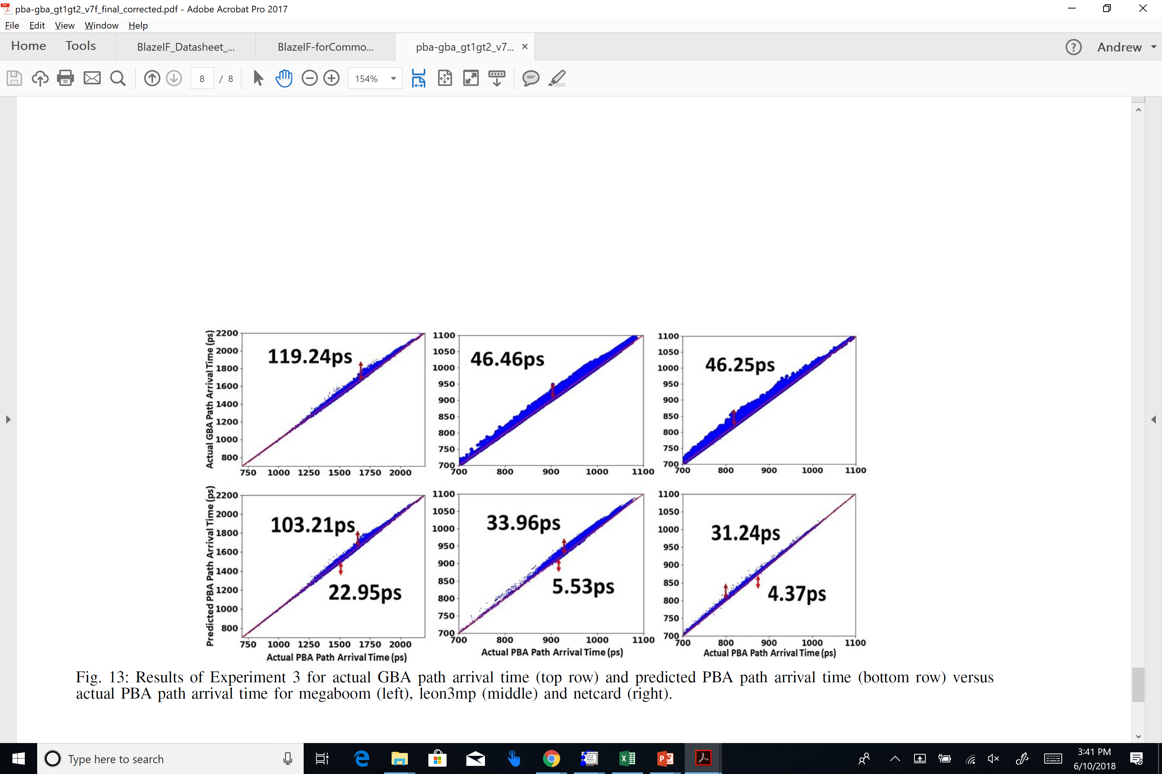
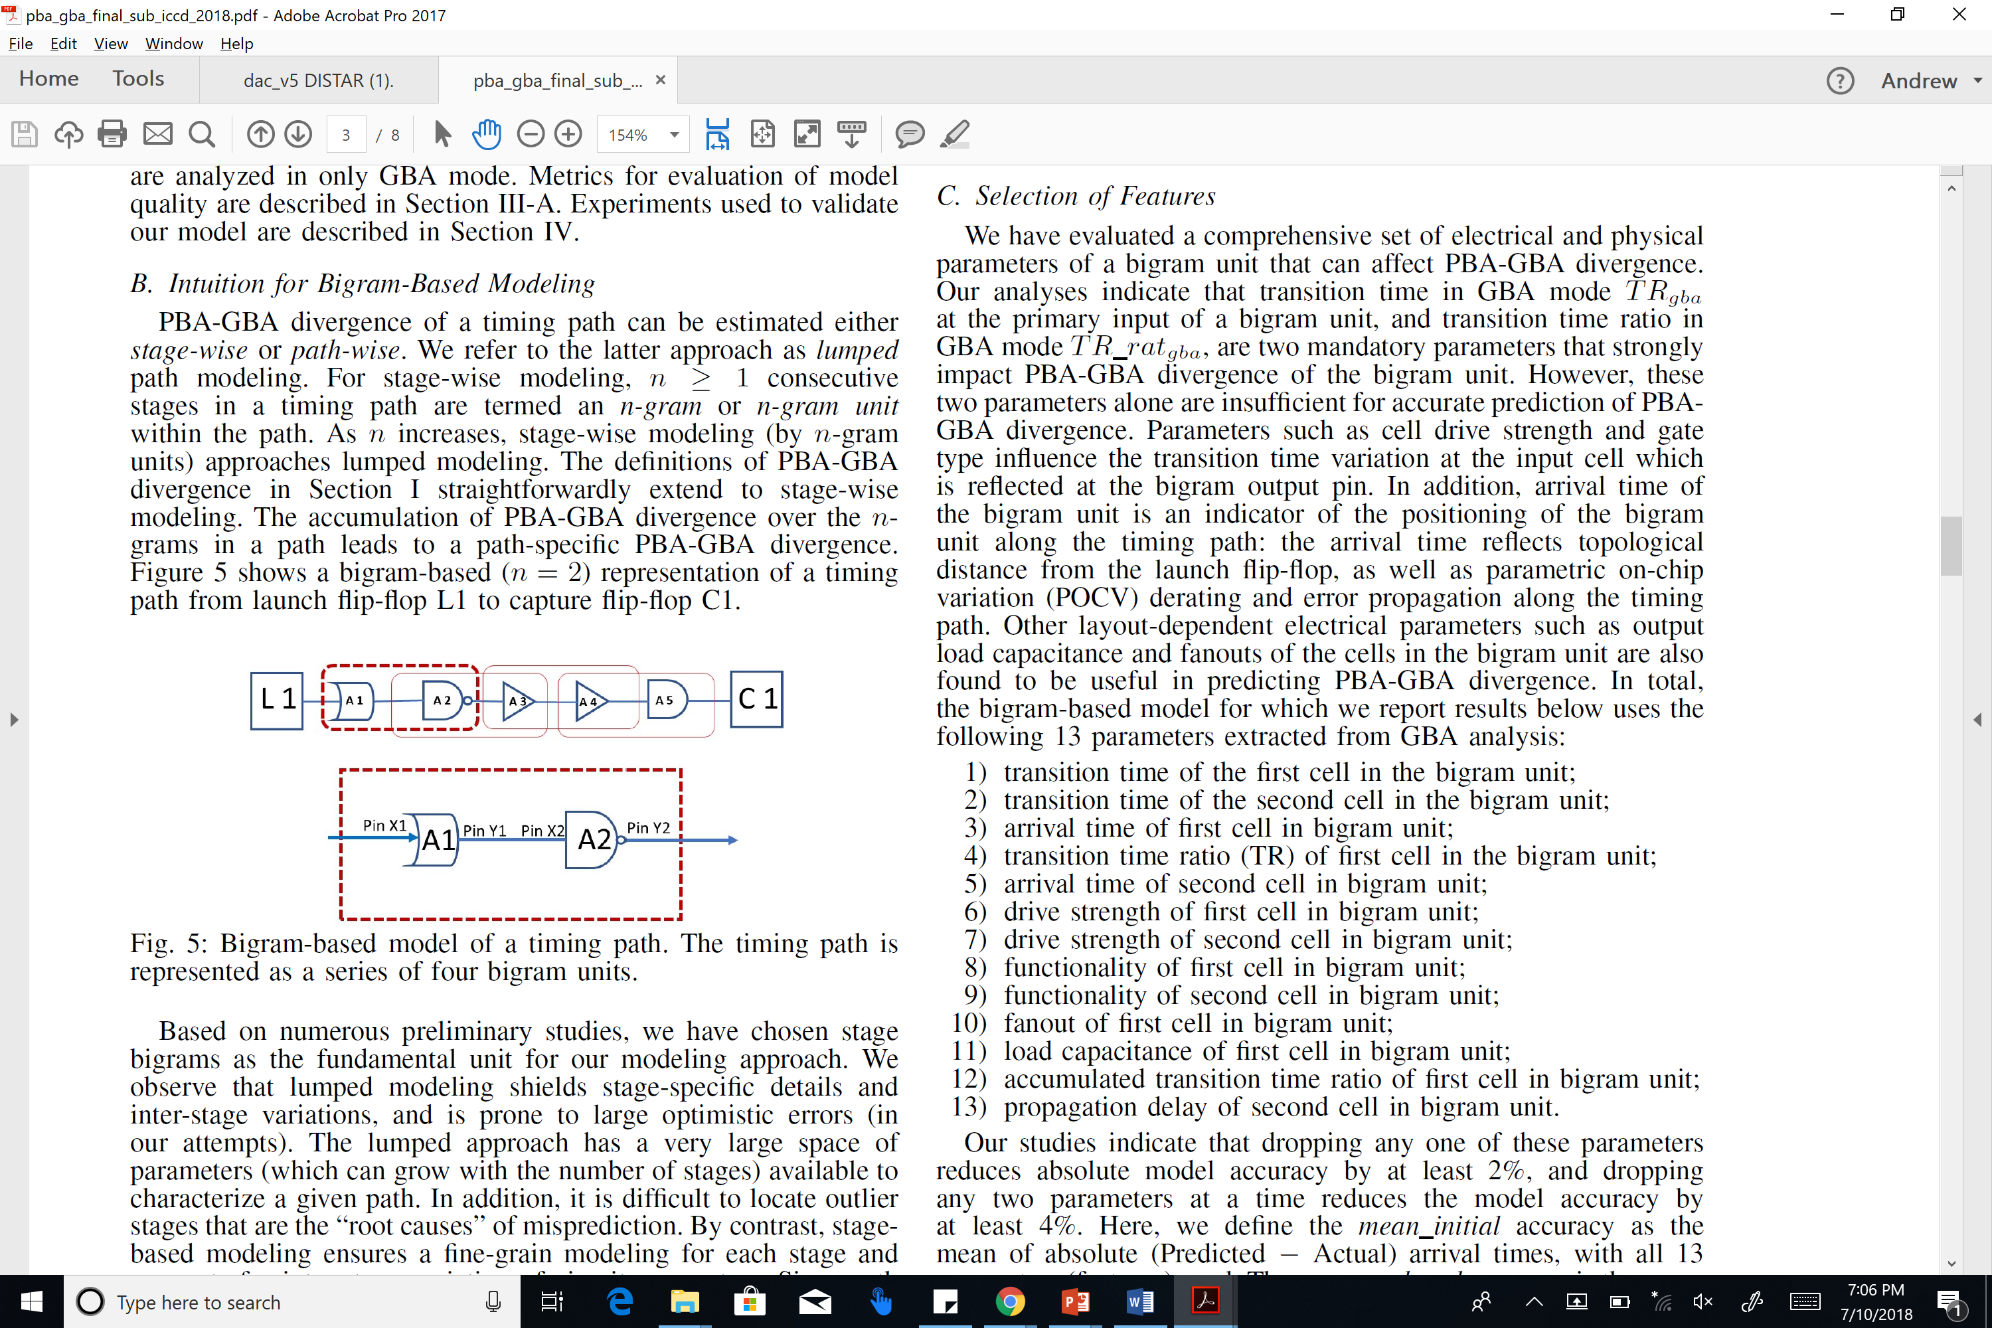
Bigram- and CART-based Modeling
Bigram-based path modeling
Classification and regression tree (CART) approach
Model based on 13 bigram parameters
Reduced GBA pessimism vs. PBA
Notes:
So, treating paths as two-stage bigrams, with 13 features to describe a bigram, and regression trees …
[CLICK] … we see on the right that this significantly reduces pessimism of graph-based timing analysis relative to much more expensive path-based analysis, “for free”.

Slide 42
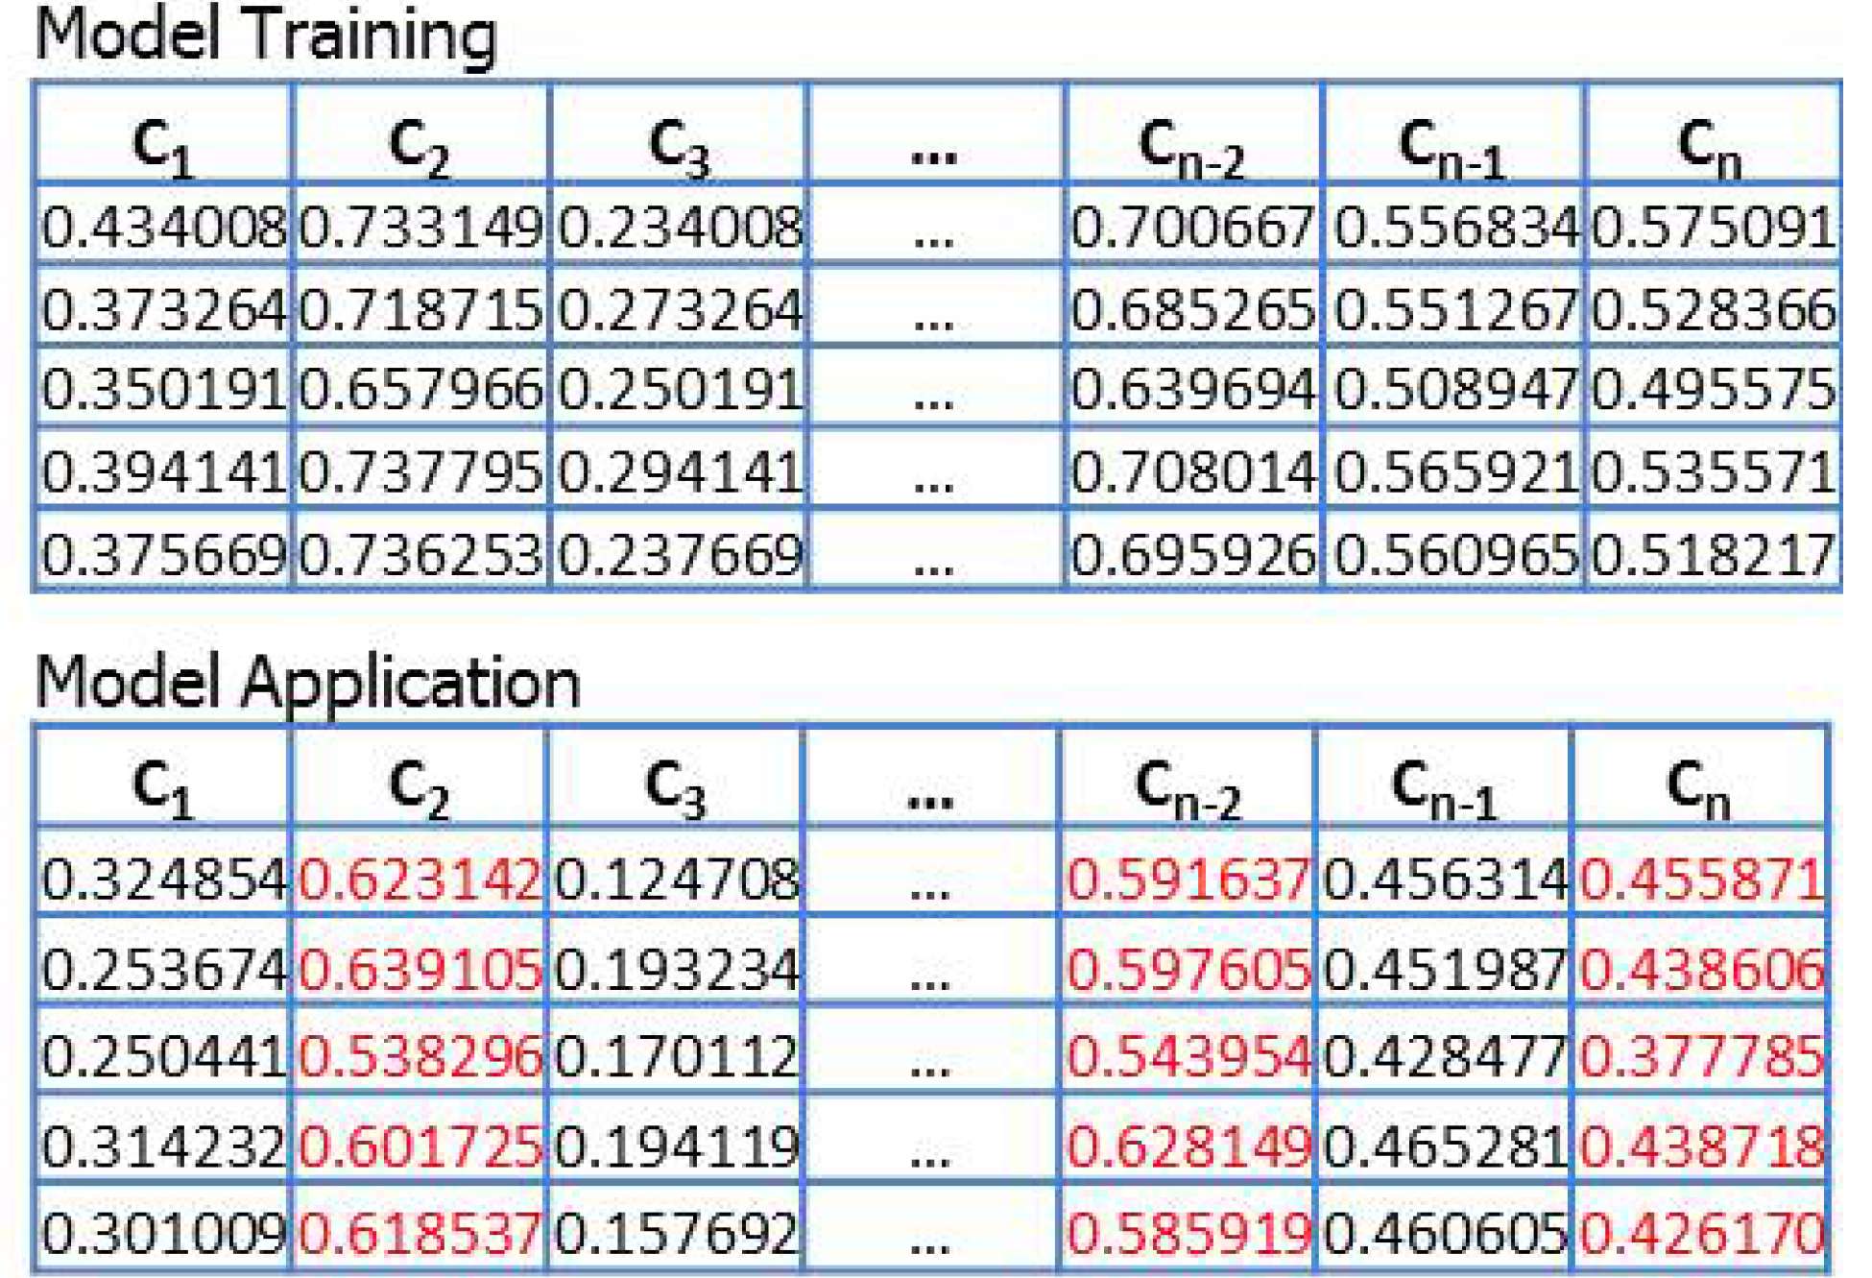
Example: Reduce #Corners in STA and Opt
DATE19
Want all the benefits of timing analysis STA at N corners, but want to pay for analysis expense of only M << N corners
“Missing Corner Prediction” (“matrix completion”) saves runtime, licenses
Avoids optimistic timing that is caught at detailed signoff, causing iteration
Notes:
Here’s another ML challenge in the arena of saving analysis cost “for free”: SAVING RUNS OF STA when the design must meet timing at hundreds of mode-corner combinations.
The goal is: Find M corners for timing analysis that allow prediction of timing – such as worst endpoint slacks – at the remaining N – M corners.
This cartoon shows how we would TRAIN a model using timing reports at all N corners. Then, we can APPLY the model to predict the RED values without running the timer (!). So, P&R and Optimization steps don’t have to be driven by only a few pessimistically chosen corners. And there are other benefit, for example, We could tell the library characterization team what models need to be available first in the design enablement.

Slide 43
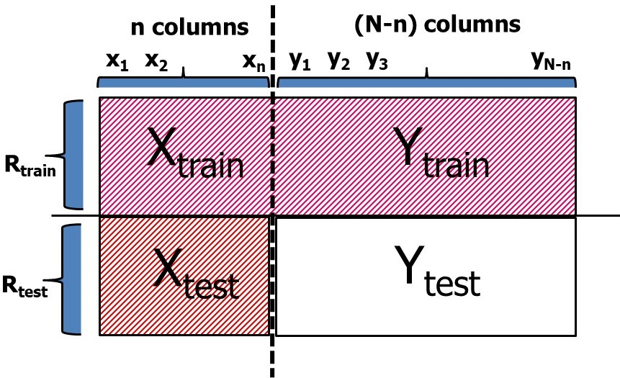
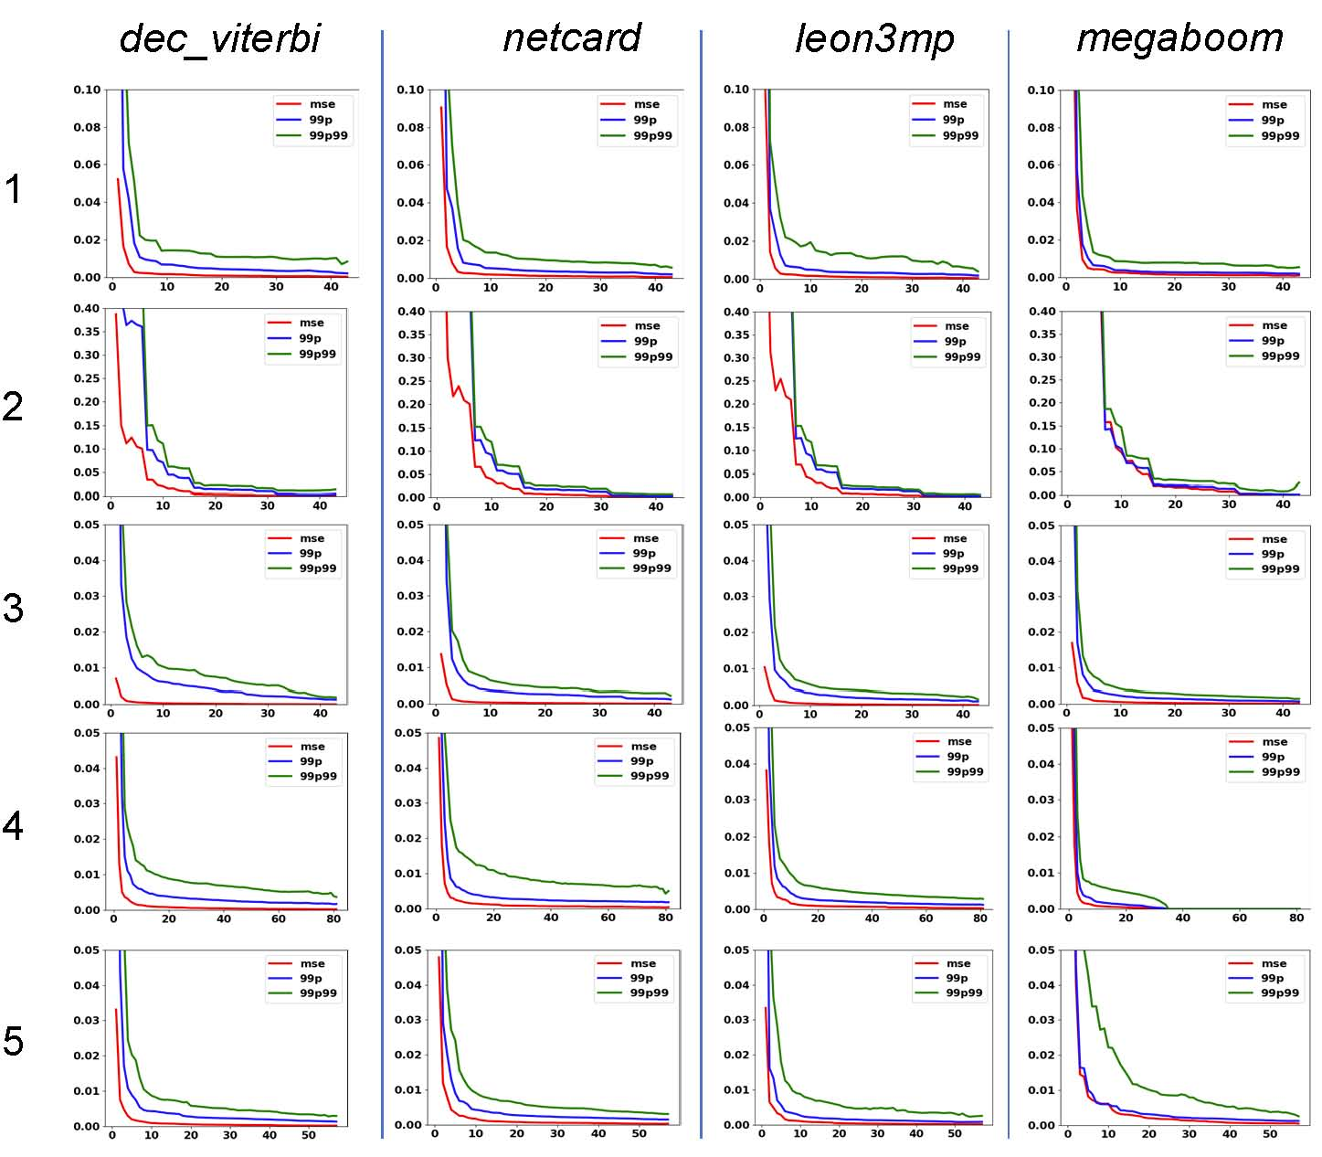
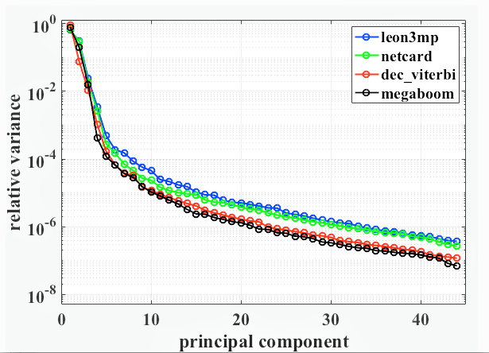
“Missing Corners” = Matrix Completion
Predicting missing delay values = matrix completion problem
STA at relatively few known corners → reasonably accurate prediction of timing at all unknown corners
PCA: low-dimensional modeling problem
Notes:
So, predicting those missing RED delay values is the problem of predicting Y_Test in this picture. CLICK. It is a classic ML problem: Matrix Completion.
CLICK. And, something that is not surprising when we realize this is physics of signal propagation in devices and wires – principal components analysis tells us that this is an inherently low-dimensional modeling problem. CLICK. A number of experiments including in 28 and 16nm foundry nodes show that STA at relatively few KNOWN corners enables accurate prediction of timing at all UNKNOWN corners – especially in realistic contexts where a given block will go through SP&R many times during the design process – we keep on learning and improving this kind of model.

Slide 44
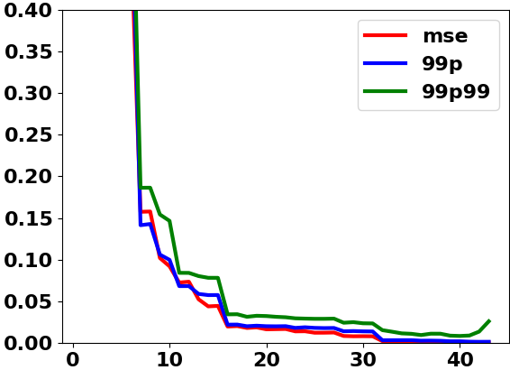
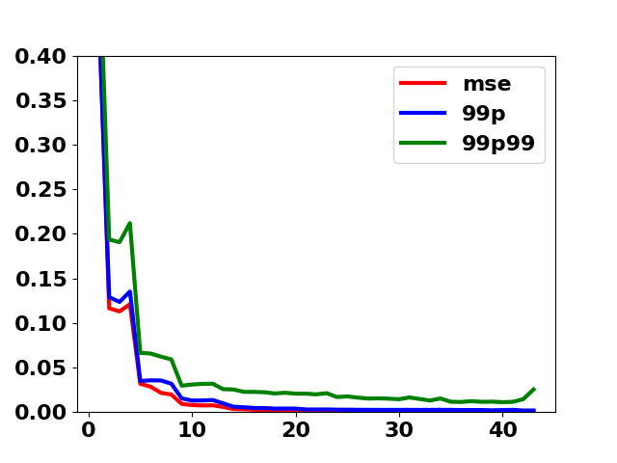
Recent: Strong Design-Independent Models
Trained using
initial artificial testcases
Trained using
richer artificial testcases
Error
10X improvement !!
# Corners
megaboom (990K instances, 350K FF)
Notes:
Back to that “where’s the data” question: This data generation is EASY. Here’s what happened when my student spent a few additional days – unfortunately, after the published paper was finalized – on generation of a richer set of artificial paths. With a few millions of additional artificial paths, we see that accuracy that took 15-20 corners is achieved with 9 – or, viewed another way, design-independent path delay prediction at missing corners has 10X less error when there is a budget of just 9 corners.
So let me say again: we’ve thought a lot about the artificial data and eyechart data and mutant data and obfuscated data generation problem over many years. We’d love to move this to a next level in collaboration with EDA, researchers and semiconductor folks.
The plot on the left shows error metric with our old artificial circuit methodology. You can find the results of this experiment under experiment 2
I would like to add latest plots on the right, for this experiment with improved and richer artificial circuits.
As evident from the plot, accuracy improved.
The reason being, improvement of our artificial circuits methodology to span wider electrical and physical attributes of a timing path.
So, with a value of “n=9 achieves a mean relative error of 0.9% or rmse of 0.009. Earlier, for n=9, this value was about 0.10 meaning 10% relative error.
This is a 10X improvement.
This paper was nominated for best-paper award, DATE 2019 and will be presented on March 26th .

Slide 45
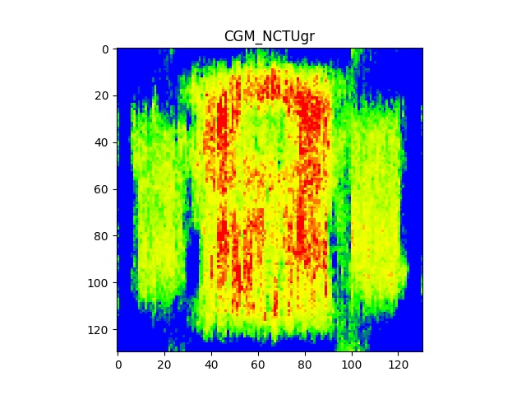
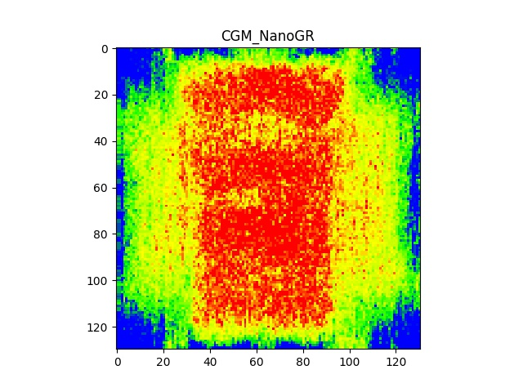
Example: Congestion Map Correlation
Would like to predict Router’s congestion map from Placer’s congestion map, “for free”
Ongoing work at UCSD
Congestion Map 1
Congestion Map 2
Notes:
Another example from APR would be prediction of routing congestion map correlation. For example, the placer has a congestion map inside, and the router has a congestion map. Learning away the miscorrelation is an ongoing work at UCSD.

Slide 46
Agenda
Motivations
Initial Target
Open Source
Machine Learning
OpenROAD is a Movement, not just a Project
Notes:
Getting near the end now ….
Please think of OpenROAD as a movement, not just a project.
OpenROAD will likely be a disappointment if this doesn’t happen.

Slide 47

Academic Contest Winners and Open-Source Tools https://github.com/The-OpenROAD-Project/Academic-Open-Source-Tool-and-Contest-Winners/wiki/Academic-Open-Source-Tool-and-Contest-Winner-Stats
2
6,3,2
1
1
2,1
30, 12, 24
16, 15
2,2
5
46,38,13
1
2,4, 2
1
1
Count of contest winners before 2010
Count of contest winners after 2010
Count of academic open-source tools
Notes:
This is a map of academic contest winners before 2010, winners after 2010, and academic open-source tools. It’s a wiki, so you can help fix up the data my students collected.

Slide 48
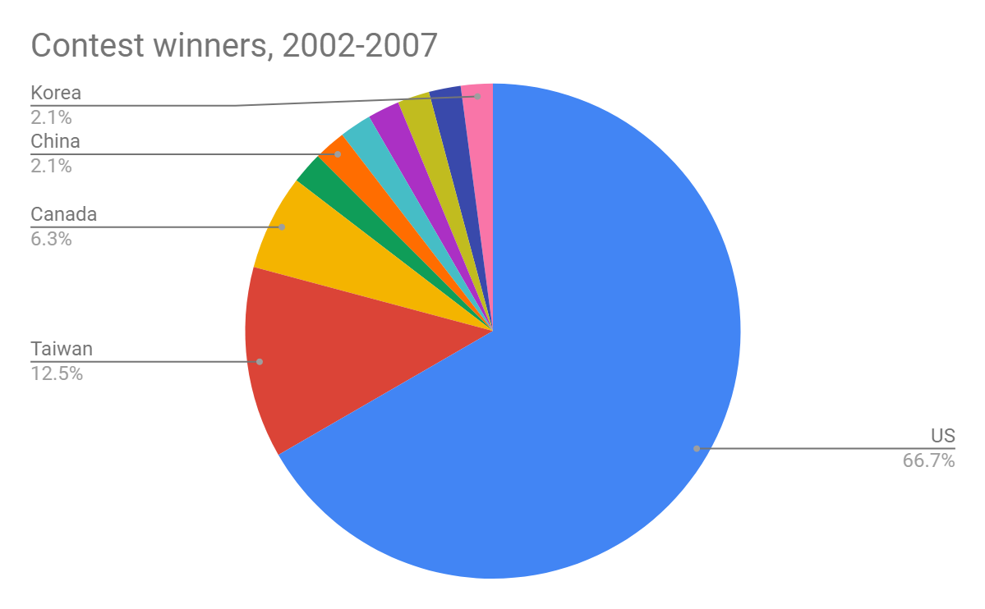
DAC, ICCAD, ISPD contest winners, 2002-2007
Notes:
In 2002-2007, 66 percent of winners were from the U.S. 12.5% from Taiwan.

Slide 49
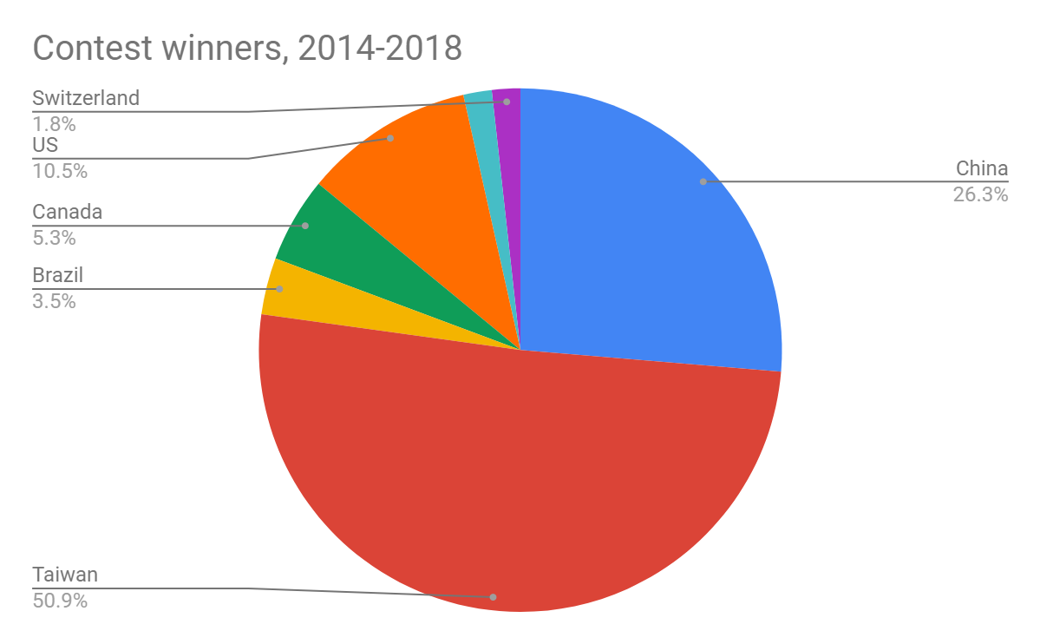
DAC, ICCAD, ISPD contest winners, 2014-2018
Notes:
In the past 5 years, more than half are from Taiwan, more than a quarter from China.
The U.S. is the orange slice: 10%.

Slide 50
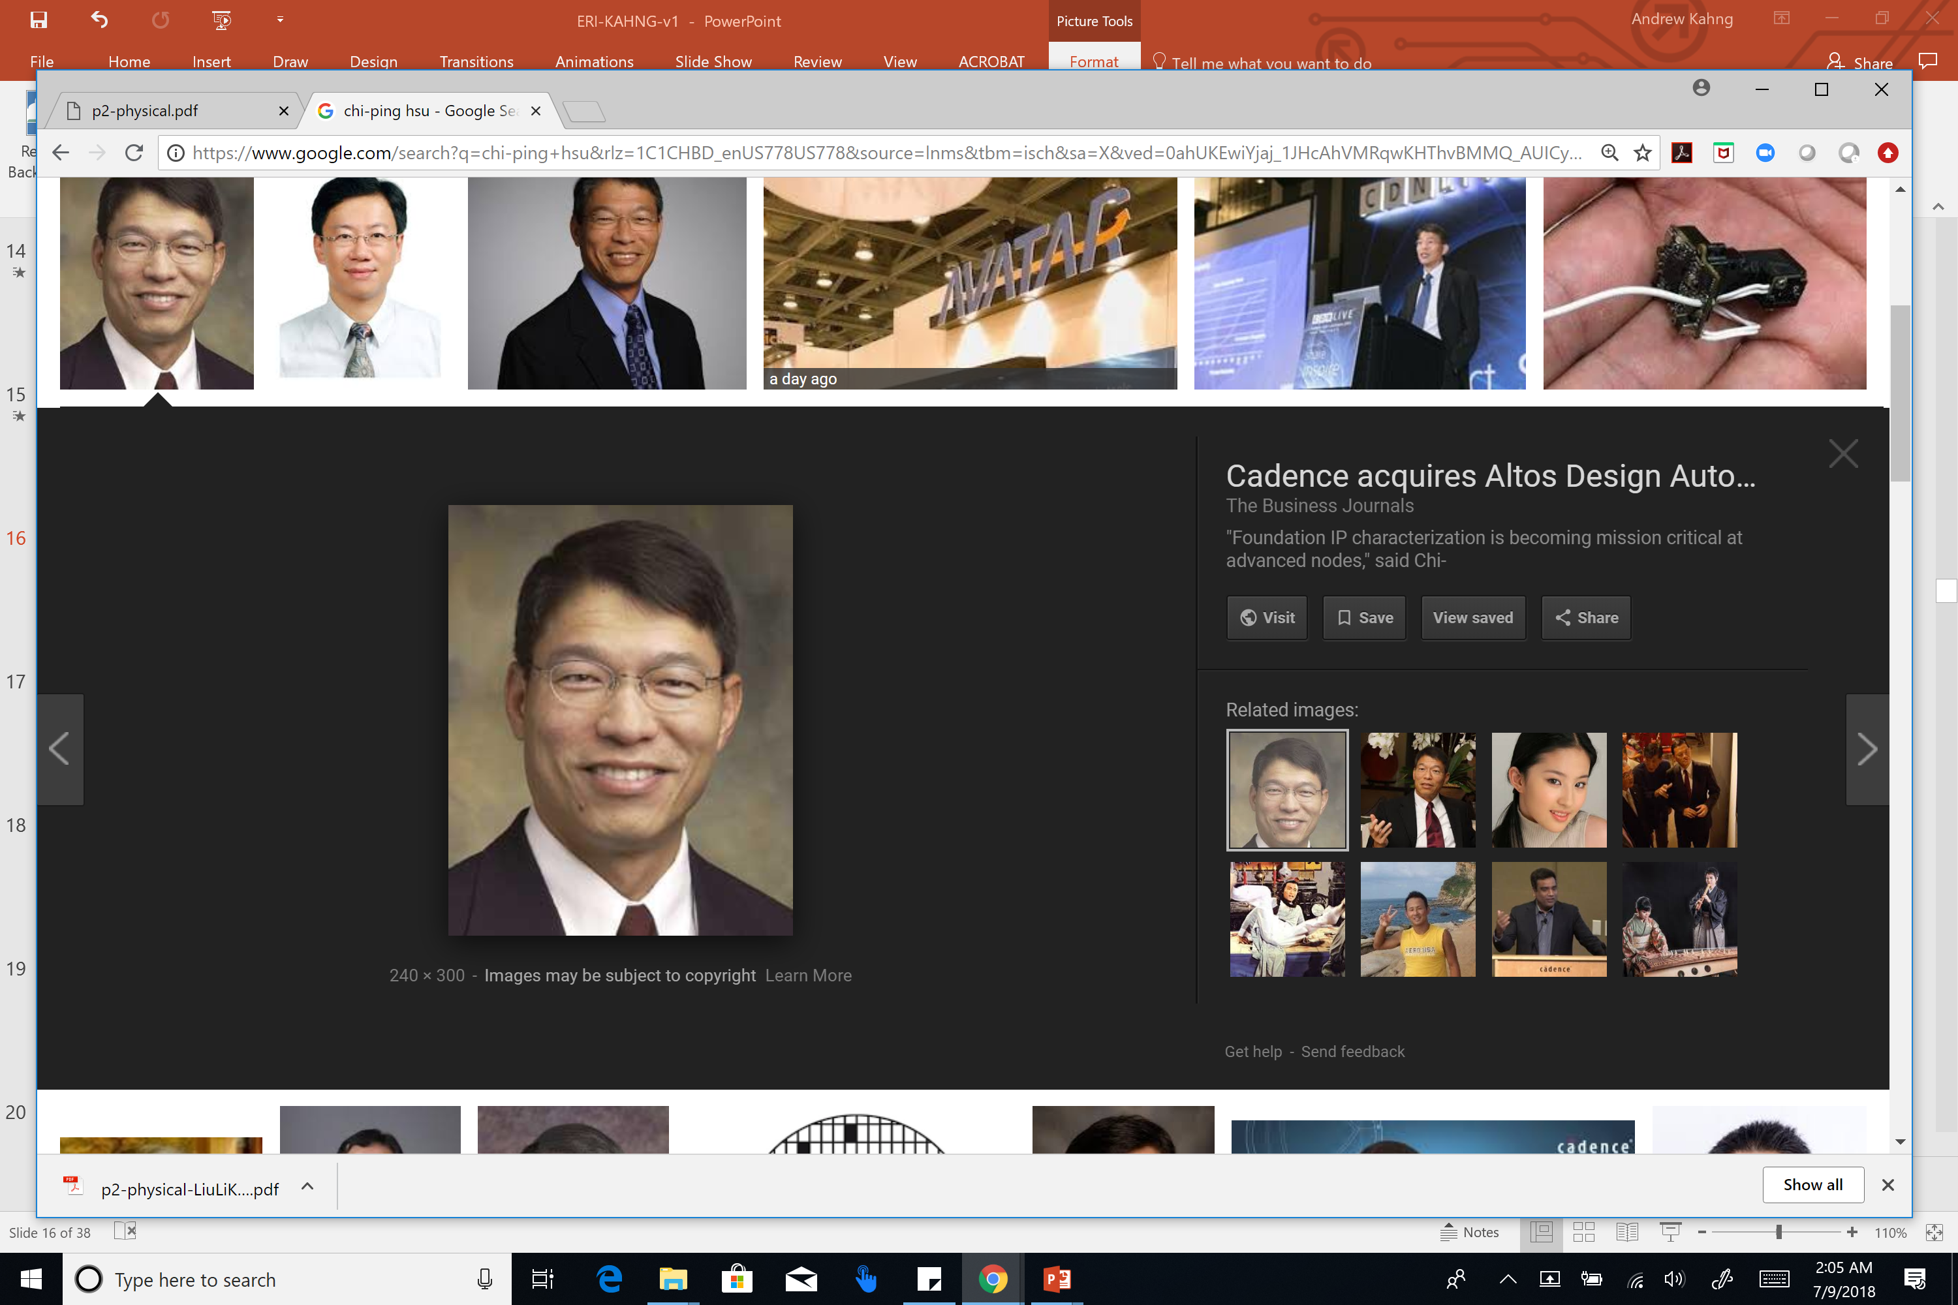



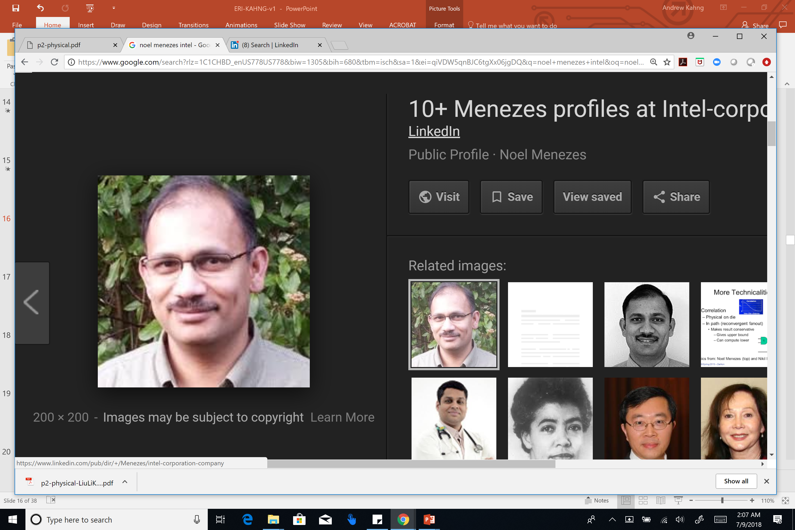
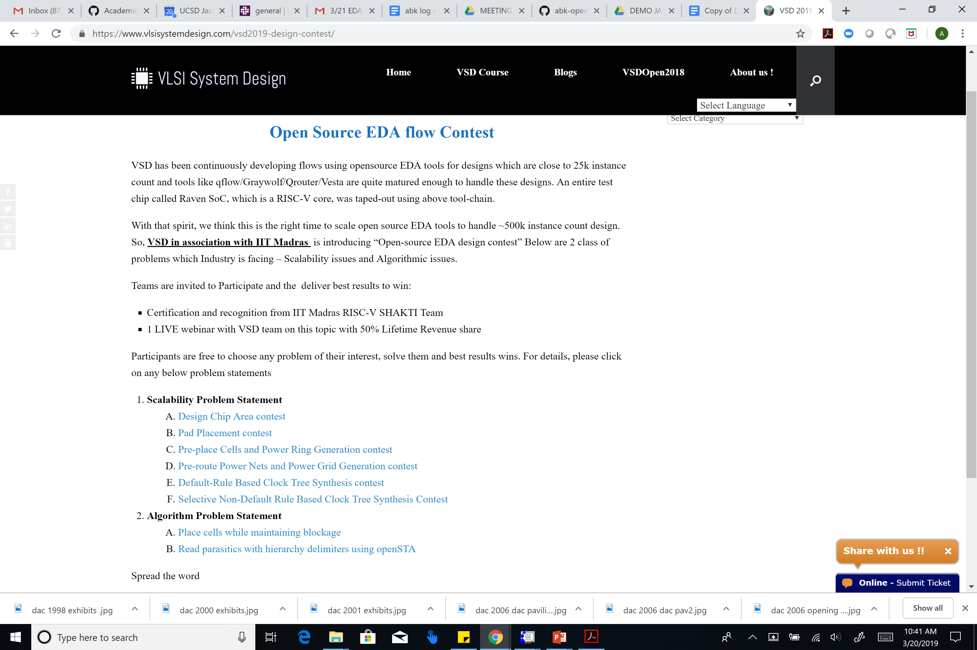



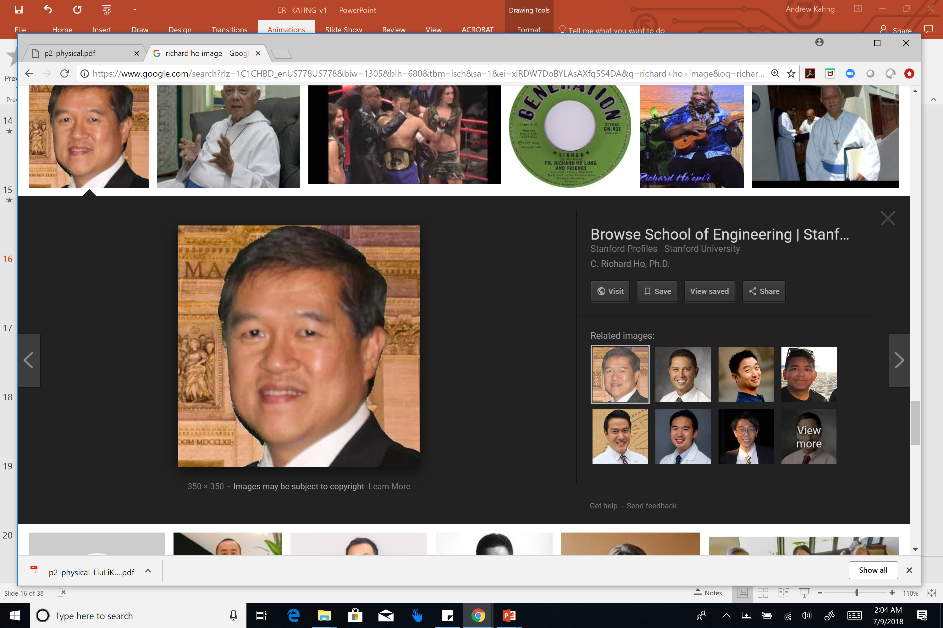




Key Concern: Broad Support of Project Goals
November 2017 proposal: Key letters of support, company commitments to help with donated IP
Now is a good time for engagement ☺
And, a good time to lead by example ... ☺
Notes:
From day one: my biggest fear was to repeat the Bookshelf experience.
So in our proposal, we obtained support from leaders – NTU, for example. Intel, Google, CUHK…
[CLICK] Now is a good time to lead by example, because open-source is coming. Here’s a contest put on by IIT Madras in India.

Slide 51
Today: Clear Opportunities to Collaborate
Rebooting our research infrastructure, culture
Resourcing the path to “No Humans, “24-Hours”
Big data creation for machine learning can we divide and conquer?
Testcases: open SOC designs and target metrics
Design enablements: “common design kit”, “common library”
Culture change across a field → across industry, ecosystem
“Structural” hurdles for academic FOSS in EDA
Not foundry-qualified → can’t see encrypted enablements
OpenROAD currently uses .cfg files, one-time characterization flows
No golden verifiers (DRC, STA etc.) → guardbands inevitable
What must we guarantee to support tapeout?
Not a commercial entity → bug reports come without testcases!
Requires efforts of a community to find ways forward
Notes:
I believe there are some really interesting and enjoyable opportunities to collaborate and reboot our research culture.
First: resourcing the path to “no humans, 24 hours” – or, just research and ML.
Second: figuring out how to overcome “structural” hurdles for academic open-source in EDA. Consider these three very basic challenges that we in OpenROAD face as academic researchers developing open-source IC design tools.
We need a community to find the feasible ways forward.

Slide 52
Agenda
Motivations
Initial Target
Open Source
Machine Learning
OpenROAD is a Movement, not just a Project
Key Directions for Collaboration
Gap Analyses
Notes:
So what would collaboration look like?
// Harry said: Professionals do logistics!
Let’s talk logistics. Simple idea: Let’s do some gap analyses.

Slide 53
Example of Gap Analysis
System | Planning / prototyping
 | Emulation
 | Simulation and testbench
 | Formal / static verification
Digital | Synthesis* | Detail Routing*
 | Floorplanning* | RC Extraction*
 | Global placement* | Timing & SI analysis / signoff*
 | Detail placement* | Power & PI analysis / signoff*
 | Optimization* | Reliability / DFM
 | Clock Tree Synthesis* | Physical verification & signoff
 | Global Routing* | Logic equivalence checking
Custom Analog RF | Circuit design / simulation
 | Layout design / verification
 | Library characterization
Package PCB | Package design*
 | PCB layout*
 | Analog / mixed-signal simulation
 | SI/PI analysis
*OpenROAD
Notes:
OpenROAD covers most of digital implementation flow (shown with asterisks), but doesn’t cover logical and physical verification and some manufacturing-related optimizations.
And we cover the package and PCB layout design since they share some similarities to the digital flow. There are lots of opportunities for collaboration in the OpenROAD scope.
[LW] This slide shows the notional gap between OpenROAD and the remaining IC design flow. The IC design flow can be partitioned into four main parts, system, digital, analog and package PCB.

Slide 54
Can Regions Collaborate?
Digital | Synthesis* | Detail Routing*
 | Floorplanning* | RC Extraction*
 | Global placement* | Timing & SI analysis / signoff*
 | Detail placement* | Power & PI analysis / signoff*
 | Optimization* | Reliability / DFM
 | Clock Tree Synthesis* | Physical verification & signoff
 | Global Routing* | Logic equivalence checking
Package PCB | Package design*
 | PCB layout*
 | Analog / mixed-signal simulation
 | SI/PI analysis
Global routing, CTS
Legalization and Detailed Placement
Physical verification (design rules checks)
Physics analyses (P/G distribution, incremental/accurate)
Formal equivalence checking
Delay calculation, other STA improvements
Openly usable library, RAM generator, IOs …
Notes:
Focusing on digital IC flow: here are some EDA capabilities that I see as gaps.
The global routing and CTS engine, physics analyses such as power grid -- can be largely improved by open-source collaboration especially with Taiwan faculty who are very strong in these areas.
We also need a industry-strength legalization and detailed placement engine
Others can also contribute to the formal/ physical verification/analysis to broaden the OpenROAD coverage

Slide 55
Agenda
Motivations
Initial Target
Open Source
Machine Learning
OpenROAD is a Movement, not just a Project
Key Directions for Collaboration
Gap Analyses
METRICS Infrastructure for ML
Notes:
And we can collaborate on the enablement of ML for EDA and IC DESIGN !!!

Slide 56
ML in IC Design Requires Infrastructure !
Support for ML in IC design
Standards for model encapsulation, model application, and IP preservation when models are shared
Standard ML platform for EDA modeling
Enablement of design metrics collection, tool/flow model generation, design-adaptive tool/flow configuration, prediction of tool/flow outcomes
This recalls “METRICS” http://vlsicad.ucsd.edu/GSRC/metrics
Datasets to support ML
Real designs, Artificial designs and “Eyecharts”
Shared training data – e.g., analysis correlation, post-route DRV prediction, optimal sizing
Challenges and incentives: “Kaggle for ML in IC design”
Notes:
ML needs INFRASTRUCTURE. (You can see my DAC paper last year for some perspectives.)
I feel that THESE challenges are really key. A big question here is how training effort, data sets, models, abstractions of PDK information, etc. will in practice be contributed toward this long-term health of the semiconductor ecosystem.
CLICK. We need serious efforts across the industry academia to solve these questions: can trained models be shared? Can model forms (where you fit your own coefficients or synapse weights) be shared? What about a generic model of ICC2 or Innovus?
CLICK. Can we collect flex, lsf, logfile data in some common, standard way?
[CLICK] And we need training and validation data PLUS engagement of bright minds and energy !!!

Slide 57
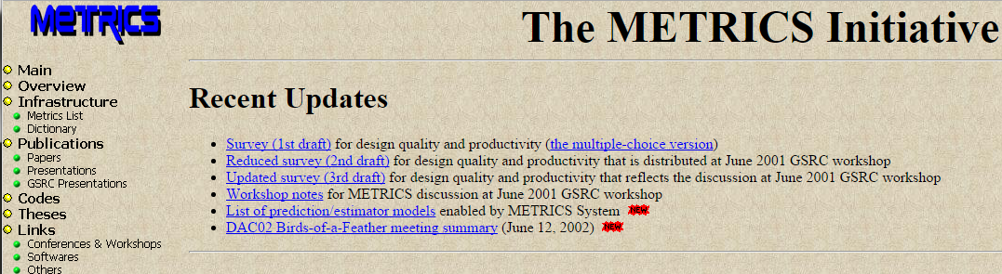
(This is “METRICS” !)
[DAC00, ISQED01]
METRICS (1999; DAC00, ISQED01):
“Measure to Improve”
Goal #1: Predict outcome
Goal #2: Find sweet spot (field of use) of tool, flow
Goal #3: Dial in design-specific tool, flow knobs
http://vlsicad.ucsd.edu/GSRC/metrics
Notes:
Back in the late 1990s, my group tried to establish a METRICS infrastructure for the EDA and IC industries – all design activity would be measured, all data would be mined, and we’d be able to predict tool outcomes, find sweet spots or field of use for tools, and make design-specific tuning of tools.
Back then, designers didn’t really want big brother watching them – but today, anything that might help is welcome.
Proprietary logfiles? We published a standard METRICS list and dictionary.
Methods and Models as IP? All codes and scripts were open sourced – and they still are?
EDA vendor sensitivity? [[CLICK]] Back then: It was fine to say exactly how we predicted Cadence QPlace wirelength from netlist and utilization – and this even got a best paper award.
Use of Oracle 8i back then becomes Splunk today. Data mining is now called Machine learning. But this is still what the field needs.

Slide 58
Original METRICS Architecture
Instrumentation of design tools:
Wrapper scripts to extract data from outputs and logfiles,
Callable API codes that allow direct interaction from within the design tools
METRICS server: central data collection (Oracle8i)
Data mining process: analyzes existing data to improve existing design flow (CUBIST, etc.)
Notes:
This is the original METRICS architecture. Wrappers around design tools to collect outputs and logfiles, with transmitter APIs (especially in our own UCLA // UCSD open-source tools).
METRICS server, which was Oracle8i back then – servlets, enterprise java beans …
Data mining process – back then, we heavily used an academic classifier called CUBIST.
This can all be done much more smoothly and powerfully today ! Imagine what modern techniques might be able to discover and enable!

Slide 59
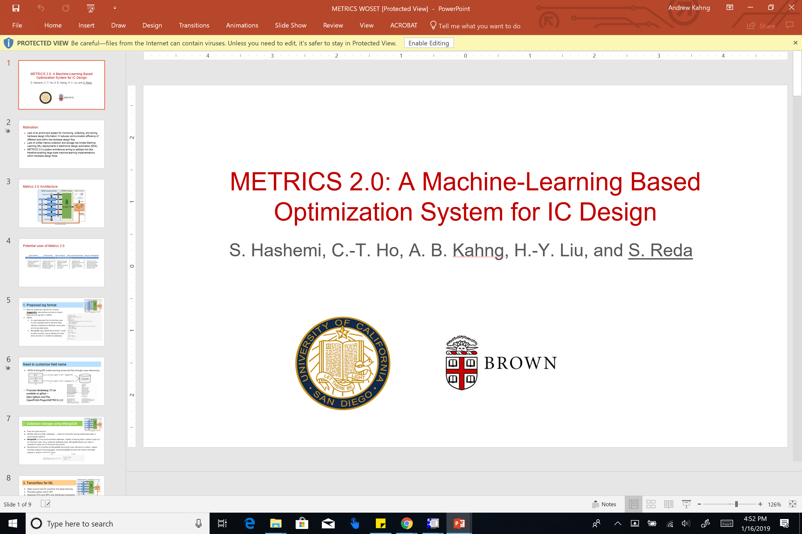
A Proposed METRICS 2.0 Architecture
White paper, WOSET-2018
woset.org
Notes:
I’m still not a professional, but let me talk some more about logistics …. !
Metrics extraction to MongoDB to inbuilt TensorFlow … this is implemented in our project. At least, in the spirit of:
So a journey of a thousand li or miles starts with a single step.

Slide 60
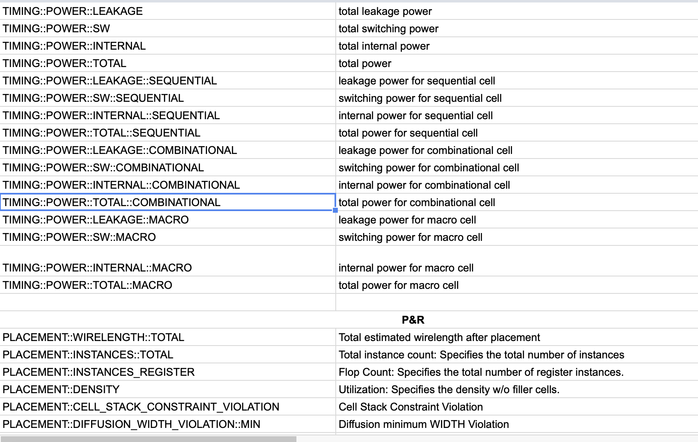
METRICS 2.0 Dictionary → Standard Naming
JSON & MongoDB enable learning across the flow through cross referencing
tool1
{“net_name”:”n123”, “length”:45}
….
MongoDB
tool2
{“net_name”:”n123”, “parasitics”:5}
….
Ongoing efforts toward METRICS 2.0 dictionary
Goal: Make available on GitHub
https://github.com/The-OpenROAD-Project/METRICS-2.0
Contributions / collaboration welcome! → if you are interested, please email to abk@ucsd.edu
Notes:
We have a strawman METRICS 2.0 naming convention and metrics dictionary,
across synthesis, placement, clock tree synthesis, routing, timing and power analysis.
Some metrics cross tools (e.g., “number of instances”,
“total instance area”); or are (e.g., “number of
congested global cells” in the routing tool or “number of
Maxtrans violations per corner” in STA, as well as flow-related metrics (e.g., “tool
name”, “tool version” and “total runtime”). If you want to help us refine this, please contact me !
This is our view of how to machine learning and prediction of
design flow outcomes, tool sweet spots, and design-specific
tuning of tool executions. The METRICS 2.0 dictionary will
be made available on GitHu

Slide 61
Example METRICS 2.0 Dictionary Entries
METRICS2.0 metric | Definition | Flow Stage | Collectable from tool reports? | Derivable from tool run data?
SYNTHESIS::INST::COMB | Total #Comb Instances | Synth | Y | Y
SYNTHESIS::INST::REG | Total #Registers | Synth | Y | Y
PLACEMENT::INSTANCES::TOTAL | Total #Instances | Place | Y | Y
PLACEMENT::PIN_DENSITY | Ratio of Total #Pins / Total Area | Place | N | Y
PLACEMENT_OPT::POWER::TOTAL | Total power after preCTS Opt | Place | Y | Y
CLOCK::INST | Total #Clock Insts | CTS | Y | Y
CLOCK::TIMING::SETUP::TNS | Total TNS of timing paths | CTS | Y | Y
CLOCK::TIMING::SKEW::AVG | Average clock skew | CTS | Y | Y
ROUTING::DRC::TOTAL | Total DRC Count | Routing | Y | Y
ROUTING::VIA::TOTAL | Total #Vias | Routing | Y | Y
ROUTING:WIRELENGTH::TOTAL | Total Wirelength | Routing | Y | Y
Let’s open doors to data + competitive edges: METRICS + Grid Computing, + Federated ML, + …
Notes:
There has been a lot of talk today about data gathering. I firmly believe that METRICS 2.0 will open the door to ACADEMICS and USERS collaborating to improve their understanding of tools and flows – we’re starting to do this with our own engines. Those of us who collaborate will gain a big competitive edge, as well!
METRICS plus GRID COMPUTING: use spare cycles or even licenses to share the burden of collecting big data, SYSTEMATICALLY.
If you’re worried about PRIVACY:

Slide 62
Idea: Federated Learning !
Centralized
Have storage and computation need on server
Exposure of METRICS to public domain
Federated
Light server, distributed, spare cycle-aware training
Data remains private
Centralized
Federated
Client
Server
Client
Server
Notes:
… Metrics 2.0 can be extended by the idea of federated learning.
Traditionally, all machine learning tasks happen in the cloud. Clients contribute their raw data. A centralized server takes all responsibility of data collection and training. This not only demands a lot from the central server, but also brings privacy concerns due to the collection of raw data.
Federated learning is recently proposed to solve both problems. In federated learning, no raw data is stored in a centralized server. Instead, clients keeps all its data and incrementally train and contribute to a better model. In this way, the model can be incrementally improved without any data sharing concerns.

Slide 63
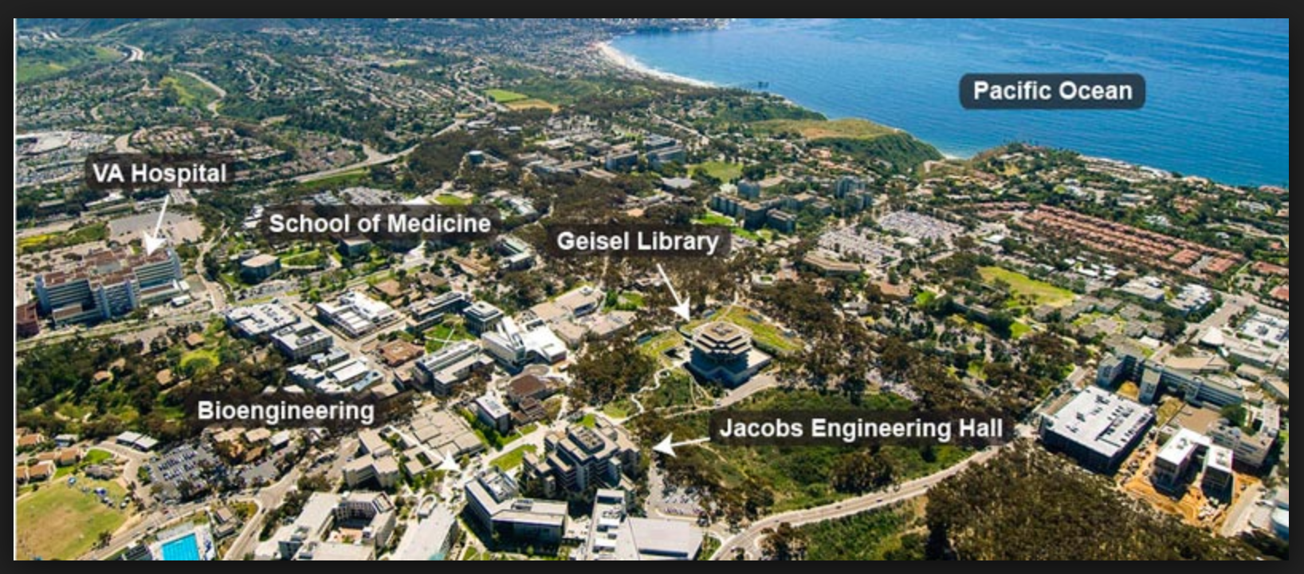
And Other Synergetic / Collaborative Efforts
Support for M.S., Ph.D. students to visit UCSD
“Visiting graduate student”
Near-equivalent to my own students’ status
Support for revival of old-but-solid works
E.g., upgrading from old academic format(“Bookshelf”) interfaces and data models
Regional leadership, coordination of OpenROAD / FOSS EDA as a world-wide movement in our field
[add ideas here]

Slide 64
Outline
Motivations
Initial Target
Open Source
Machine Learning
OpenROAD is a Movement, not a Project
Key Directions for Collaboration
Gap Analyses
METRICS Infrastructure for ML
Conclusion

Slide 65
Conclusions
OpenROAD = digital layout, no-humans, 24-hours, open source Initial progress: placement, STA, CTS, …
Open source (FOSS ecosystem, etc.) restores productivity and attractiveness of academic innovation
Scope of challenge is huge → collaboration needed
Gap analysis, world atlas of talent → this is a “no-brainer”
Machine learning is central → METRICS mindset, standards, and standard infrastructure all needed
Grid computing, federated learning, unique datasets and modeling opportunities possible
Academics (customers, EDA, design services, foundry DSD …): let’s join together
Only the best of intentions for our field, our industry
Notes:
I say this with only the best of intentions for this field which has been so enjoyable for me for 30 years.

Slide 66
Let’s get to work!
THANK YOU !
Notes:
To quote Andreas: Let’s get to work!
And on behalf of my OpenROAD teammates, thank you for your attention!

Slide 67
BACKUP

Slide 68
List of academic open source tools:
CATEGORY | Tool | Tool provider | Download URL
Logic Synthesis | yosys | Clifford Wolf | http://www.clifford.at/yosys/
 | ABC | Alan Mishchenko | https://people.eecs.berkeley.edu/~alanmi/abc/
 | CUDD | Fabio Somenzi University of Colorado at Boulder | https://github.com/ivmai/cudd
 | Sis | UC Berkeley | https://ptolemy.berkeley.edu/projects/embedded/pubs/downloads/sis/index.htm
 | CirKit |  | https://github.com/msoeken/cirkit
Floorplanning | Parquet | University of Michigan | http://vlsicad.eecs.umich.edu/BK/parquet
 | Interconnect-Driven Multilevel Floorplanner (IMF) | National Taiwan University | http://eda.ee.ntu.edu.tw/research.htm
 | B*-tree Based Placement/Floorplanning | National Taiwan University | http://eda.ee.ntu.edu.tw/research.htm
 | TCG Based Placement/Floorplanning | National Taiwan University | http://eda.ee.ntu.edu.tw/research.htm
 | TCG-S Based Placement/Floorplanning | National Taiwan University | http://eda.ee.ntu.edu.tw/research.htm
Global Placement | Capo | Saurabh Adya, Andrew Caldwell, Andrew B. Kahng, Igor Markov, and Jarrod Roy | http://vlsicad.eecs.umich.edu/BK/PDtools/Capo/
 | GrayWolf | Ruben Undheim | https://github.com/rubund/graywolf
 | NTUPlace 2.0 | National Taiwan University | http://eda.ee.ntu.edu.tw/research.htm
Global Routing | NTHU | NTHU | https://github.com/luckyrantanplan/nthu-route
 | Multilevel Routing | National Taiwan University | http://eda.ee.ntu.edu.tw/research.htm
 | Two-pass Bottom-up Routing System | National Taiwan University | http://eda.ee.ntu.edu.tw/research.htm
 | Obstacle-Avoiding Rectilinear Steiner Tree | National Taiwan University | http://eda.ee.ntu.edu.tw/research.htm
 | Multi-Layer Obstacle-Avoiding Rectilinear Steiner Tree | National Taiwan University | http://eda.ee.ntu.edu.tw/research.htm
 | NTUgr Global Router | National Taiwan University | http://eda.ee.ntu.edu.tw/research.htm
 | Crosstalk- and Performance-Driven Multilevel Full-Chip Routing | National Taiwan University | http://eda.ee.ntu.edu.tw/research.htm
 | BoxRouter 2.0 | UT Austin | https://www.cerc.utexas.edu/utda/download/boxrouter.html
 | FastRoute | Iowa State University | http://home.eng.iastate.edu/~cnchu/FastRoute.html
 | EhRouter | University of Calgary/Waterloo
 | LEF v 5.8
 | DEF v5.8
 | Tix/Tk/Tcl 8.6
 | Lemon 3.1
 | Boost 1.67
 | Flute 3.1 | Iowa State University | http://home.eng.iastate.edu/~cnchu/flute.html
 | UTD v1.0
Detailed Routing | Qrouter | Tim Edwards | http://opencircuitdesign.com/qrouter/

Slide 69
List of academic open source tools:
CATEGORY | Tool | Tool provider | Download URL
Scan Chain Ordering | ScanOpt | UCLA/UCSD | https://vlsicad.ucsd.edu/GSRC/Bookshelf/Slots/ScanOpt/
ATPG & Fault Simulation | Atalanta-M | VT | https://ddd.fit.cvut.cz/prj/Atalanta-M/index.php?page=manual
Static Timing Analysis | OpenTimer | UIUC | https://web.engr.illinois.edu/~thuang19/software/timer/OpenTimer.html
 | Vesta | Tim Edwards | http://opencircuitdesign.com/qflow/
 | Several academic STA tools |  | https://sites.google.com/site/taucontest2017/resources
Parasitic Extraction | Magic 8.1 | John Ousterhout | http://opencircuitdesign.com/magic/
Layout vs. Schematic | netgen | Massimo Sivilotti | http://opencircuitdesign.com/netgen/index.html
Verilog Parser | Odin-II | Peter Jamieson | https://code.google.com/archive/p/odin-ii/
 |  | Ben Marshall | https://github.com/ben-marshall/verilog-parser
GDSII Generation | Magic 8.1 | John Ousterhout | http://opencircuitdesign.com/magic/
 | KLayout |  | https://github.com/klayoutmatthias/klayout
DRC | Magic 8.1 | John Ousterhout | http://opencircuitdesign.com/magic/
Physical Design Framework | Rsyn | Universidade Federal do Rio Grande do Sul | https://github.com/rsyn/rsyn-x
 | Ophidian | Federal University of Santa Catarina | https://github.com/csguth/ophidian
 | Proton | efabless | https://github.com/efabless/proton
Verilog to Routing flow | VTR (ODIN II, ABC, VPR) | Toronto | https://github.com/verilog-to-routing/vtr-verilog-to-routing
Full design flow | flow to stitch existing binaries | KAIST | https://github.com/jinwookjungs/datc_robust_design_flow
FPGA-SPICE | from VPR to SPICE netlists | University of Utah | https://sites.google.com/site/pegaillardon/fpga-spice
verilog simulator | icarus verilog | Tim Edwards
Library | Ophidian | Chrystian Guth, Renan Netto, and Vinicius Livramento, under the advise of Prof. José Güntzel | https://gitlab.com/eclufsc/ophidian

